Slide 1
Presentation Matters:
How to Communicate Science in the NLP Venues and in the Wild?
Sarvnaz Karimi, Cécile Paris, Reza Haffari
Tutorial at The 62nd Annual Meeting of the Association for Computational Linguistics, Bangkok, Thailand, 2024
Notes:
Introductory tutorial - some material is similar to a research method course
Some specific to ACL, such as those in the social media

Slide 2

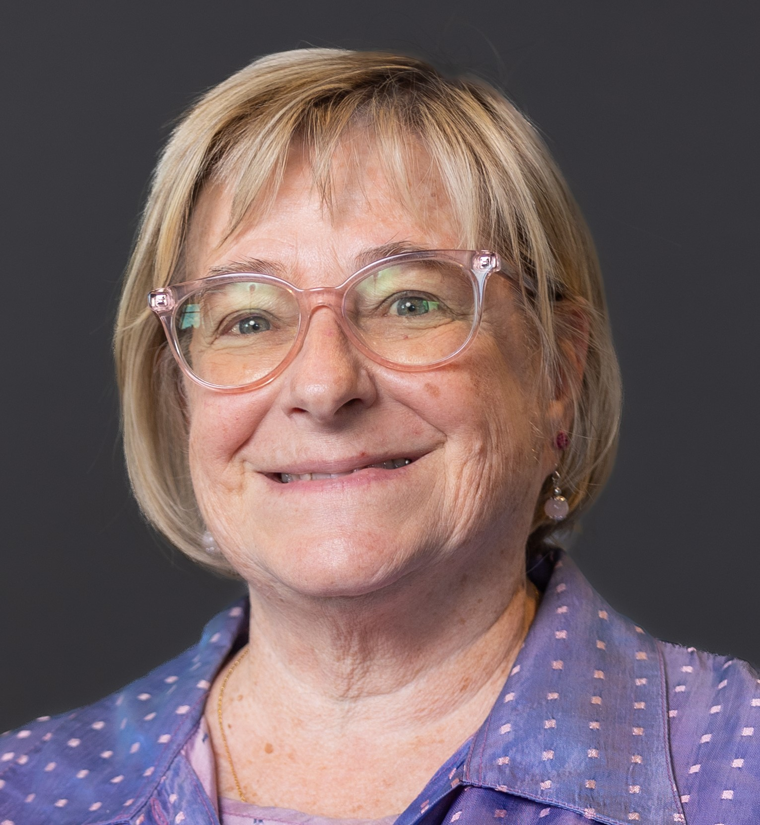
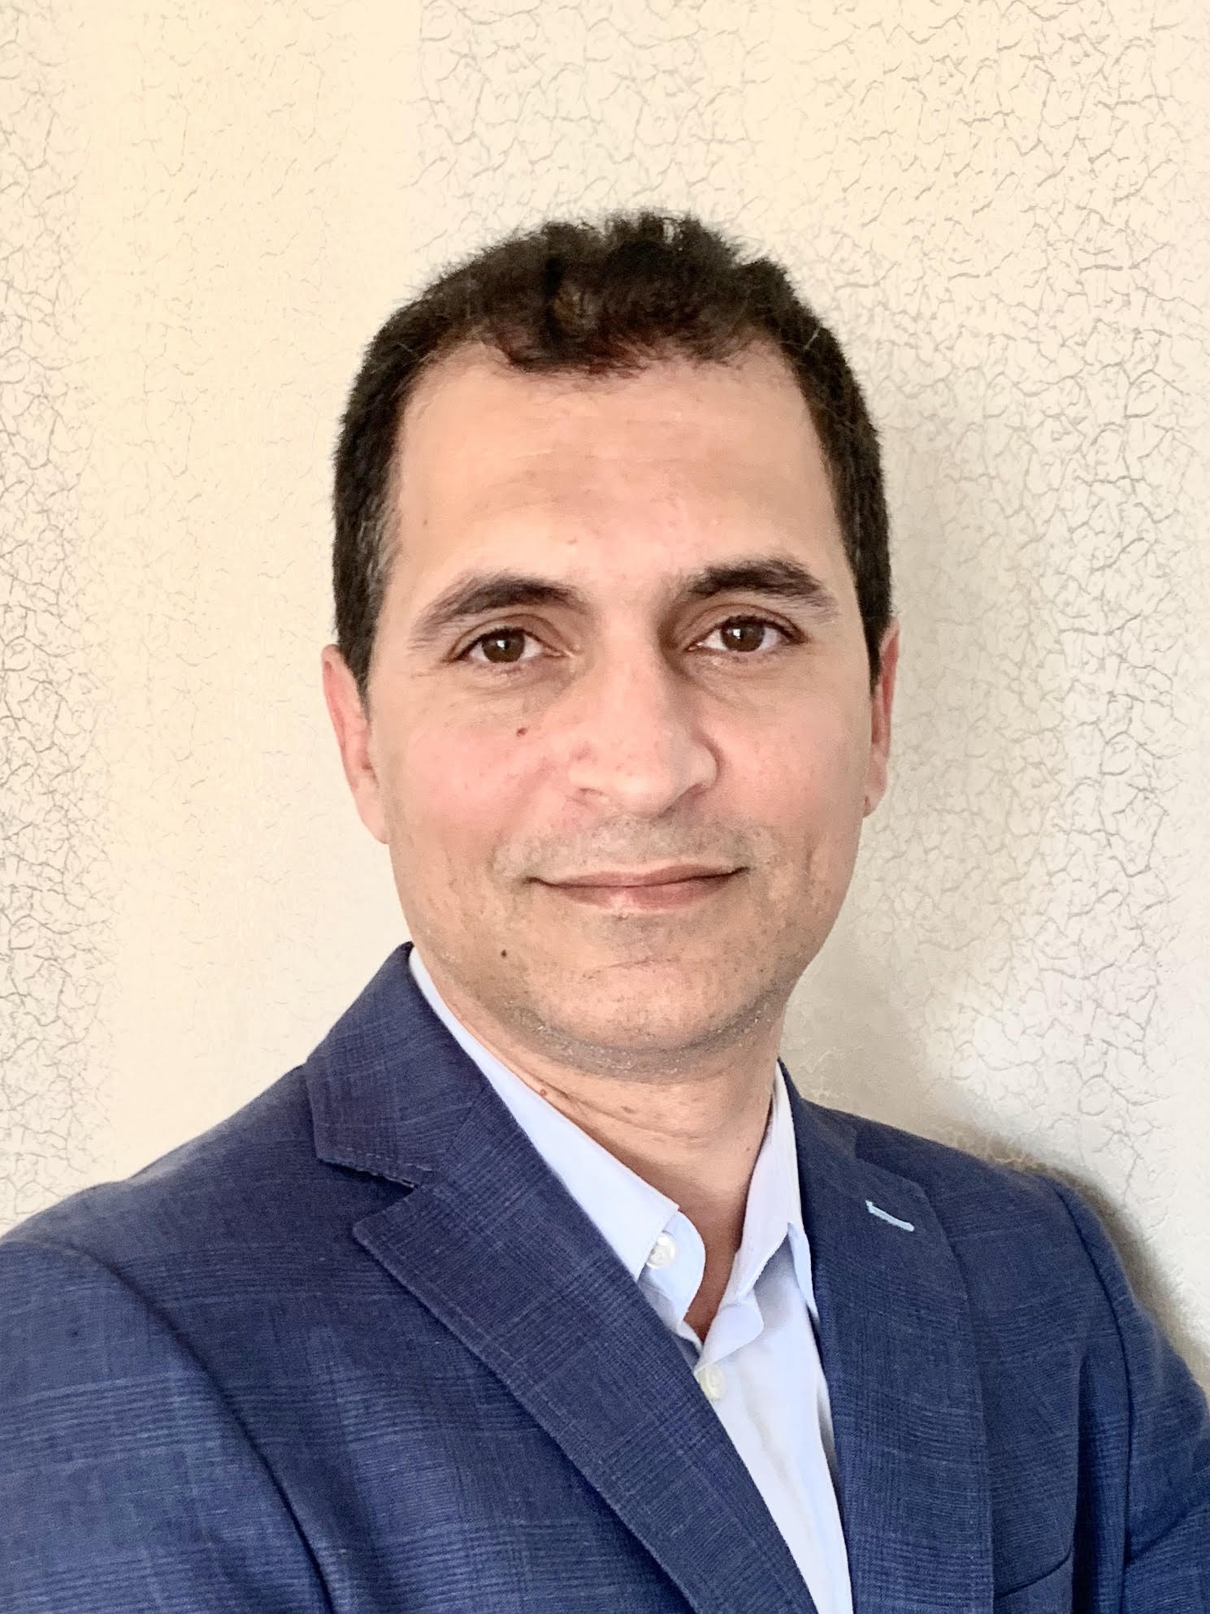
Instructors
Sarvnaz Karimi
Principal Research Scientist
CSIRO Data61
Cécile Paris
Chief Research Scientist
CSIRO Data61
Reza Haffari
Professor, ARC Research Fellow
Monash University

Slide 3

Disclaimer
These are our personal views on the subject matter based on our career experience. Please always double check the formal guidelines of ACL, the board of your professional community, publication venues, social media platforms, and your workplace.

Slide 4
Scientific communication comes in different forms
Writing ACL papers
Oral Presentation
Poster and Demo Presentation
Social media
Interviews
Notes:
Should we ask the question? (to engage the audience): have you ever heard a bad presentation? Read a paper you thought was not good?

Slide 5
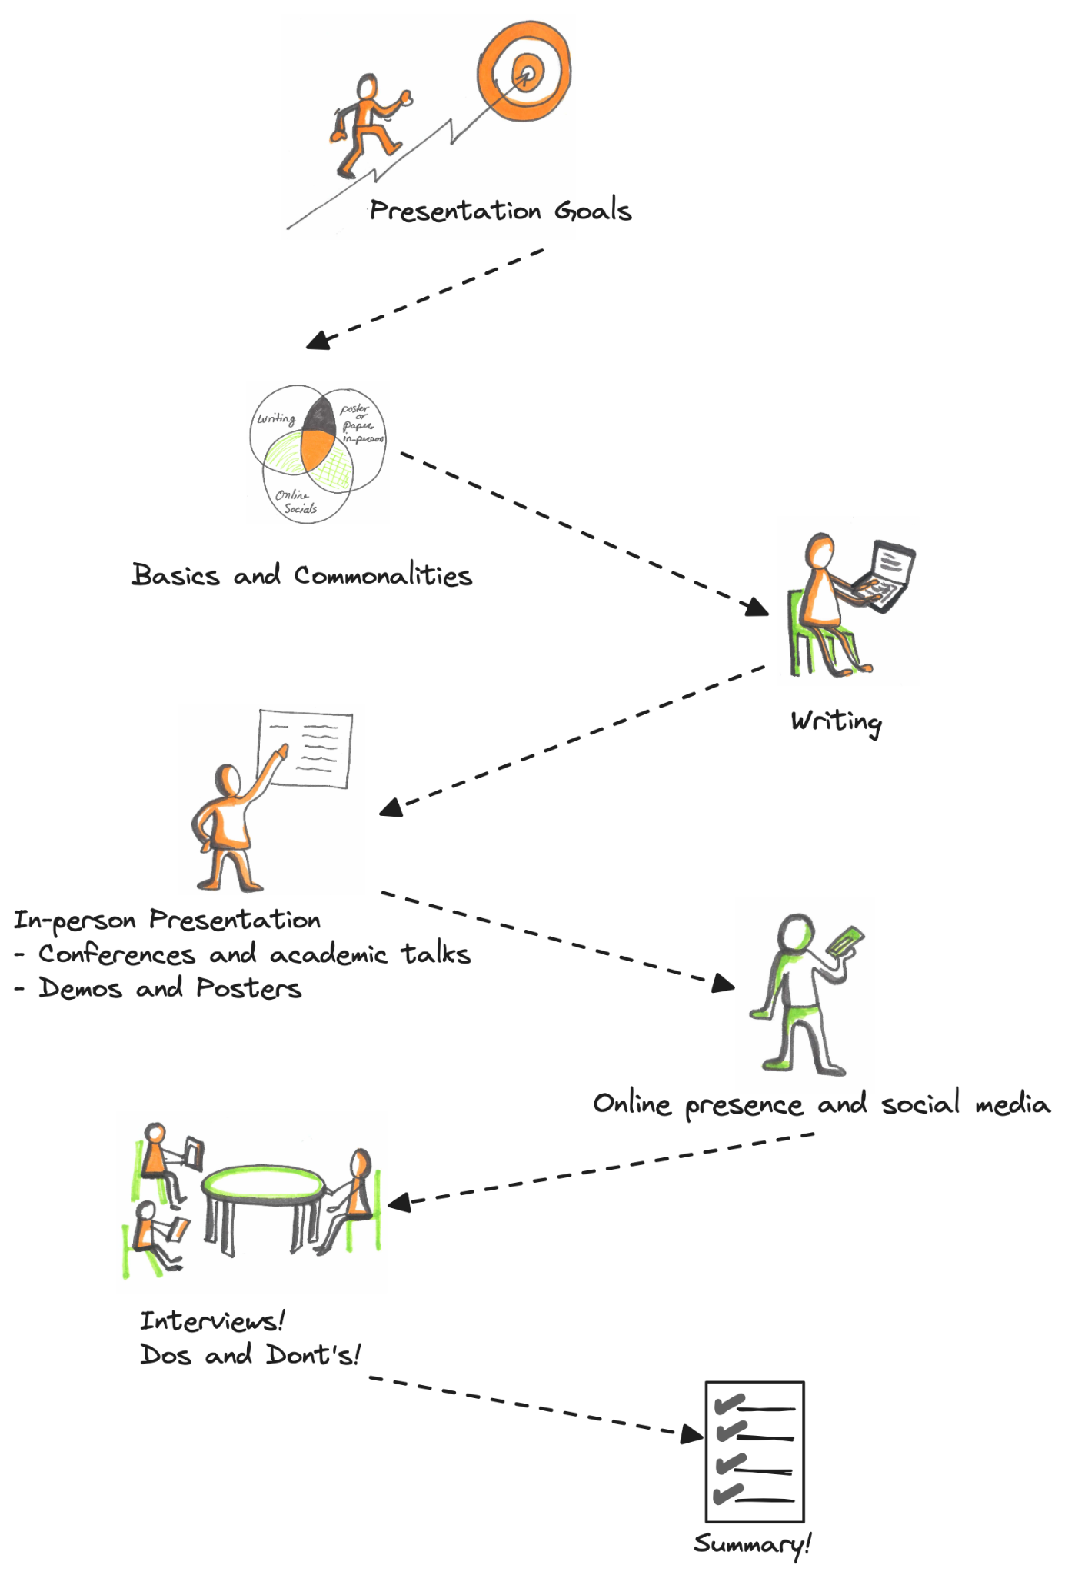
Tutorial outline
Notes:
To do: put time estimates here.

Slide 6
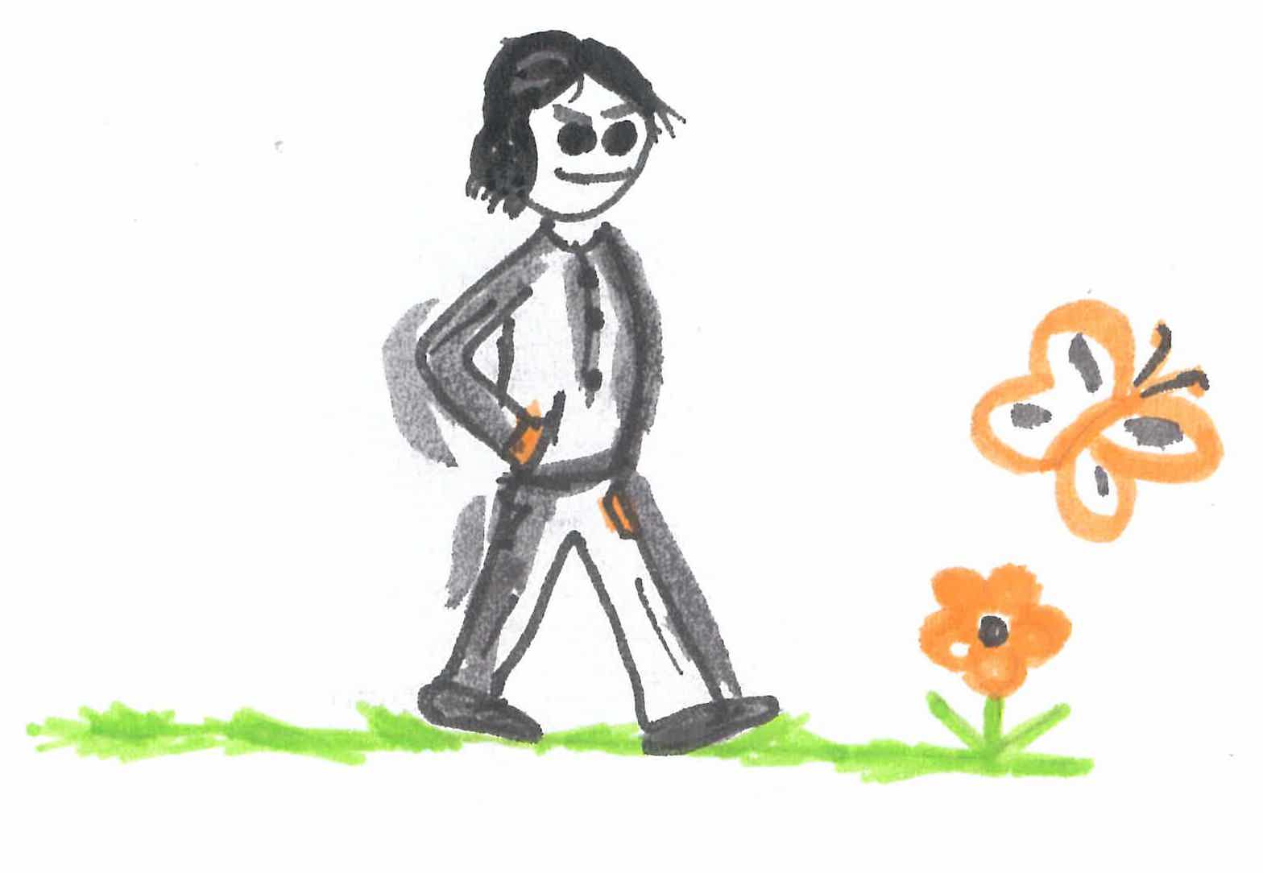
First things first
What idea do you want to convey?
Identify your audience - you will need to ensure your communication is tailored to them
How do you want people to perceive you/remember you?
Notes:
Also see Reza’s point slide 32: infect your audience’ mind with your idea - and about the 2 types of audiences
Mention that Reza will speak to that point too when talking about papers

Slide 7
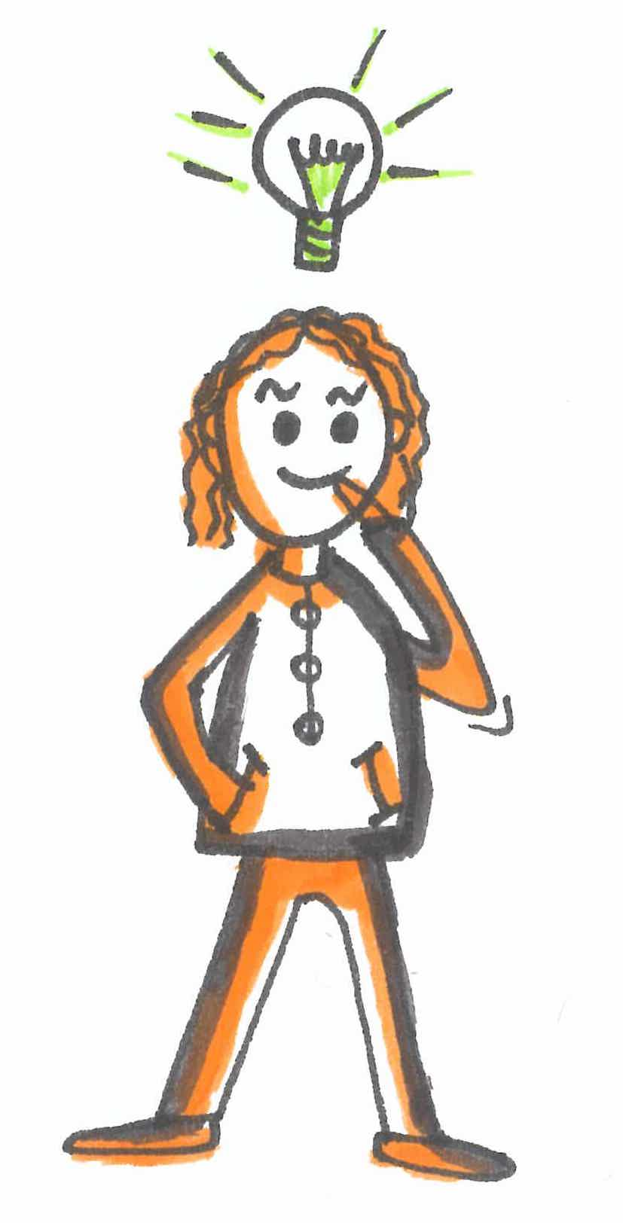
What do you want to convey?
What is the take home message: if someone needs to summarise your talk (poster, paper) to a colleague, what should they say?
and/or what action do you want them to take? (e.g., participate in a user study - give you a job)
Note: Audience will only remember 3 things
Notes:
If this is a presentation at a conference, where you have a paper, your talk is an advertisement for the paper ! you want people to read your paper; and remember it to cite it.

Slide 8
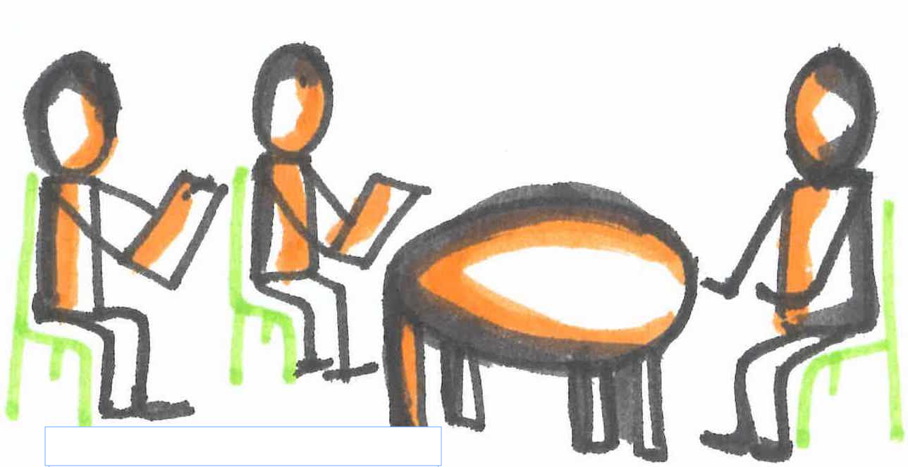
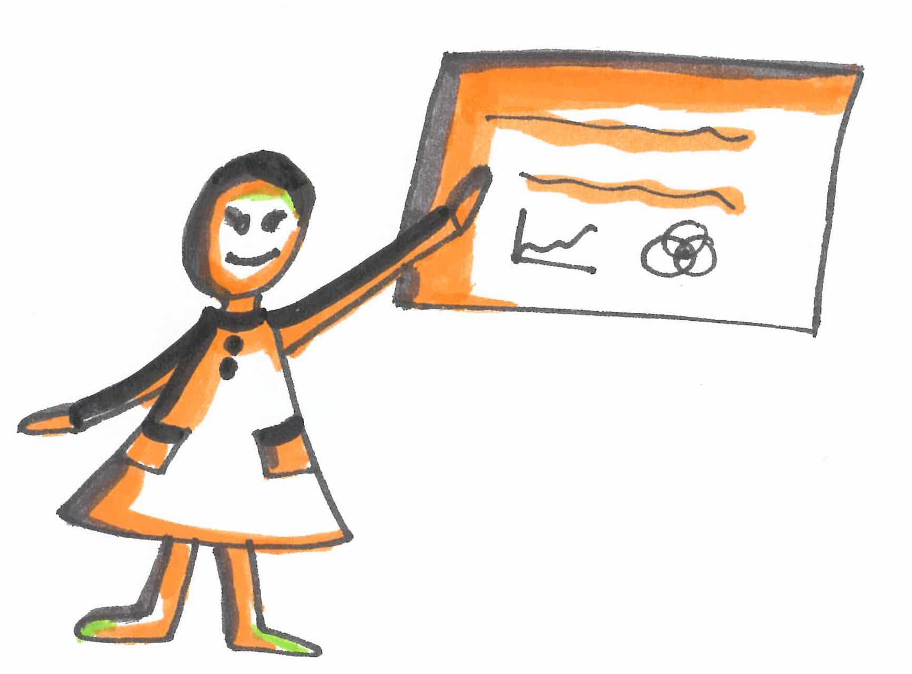
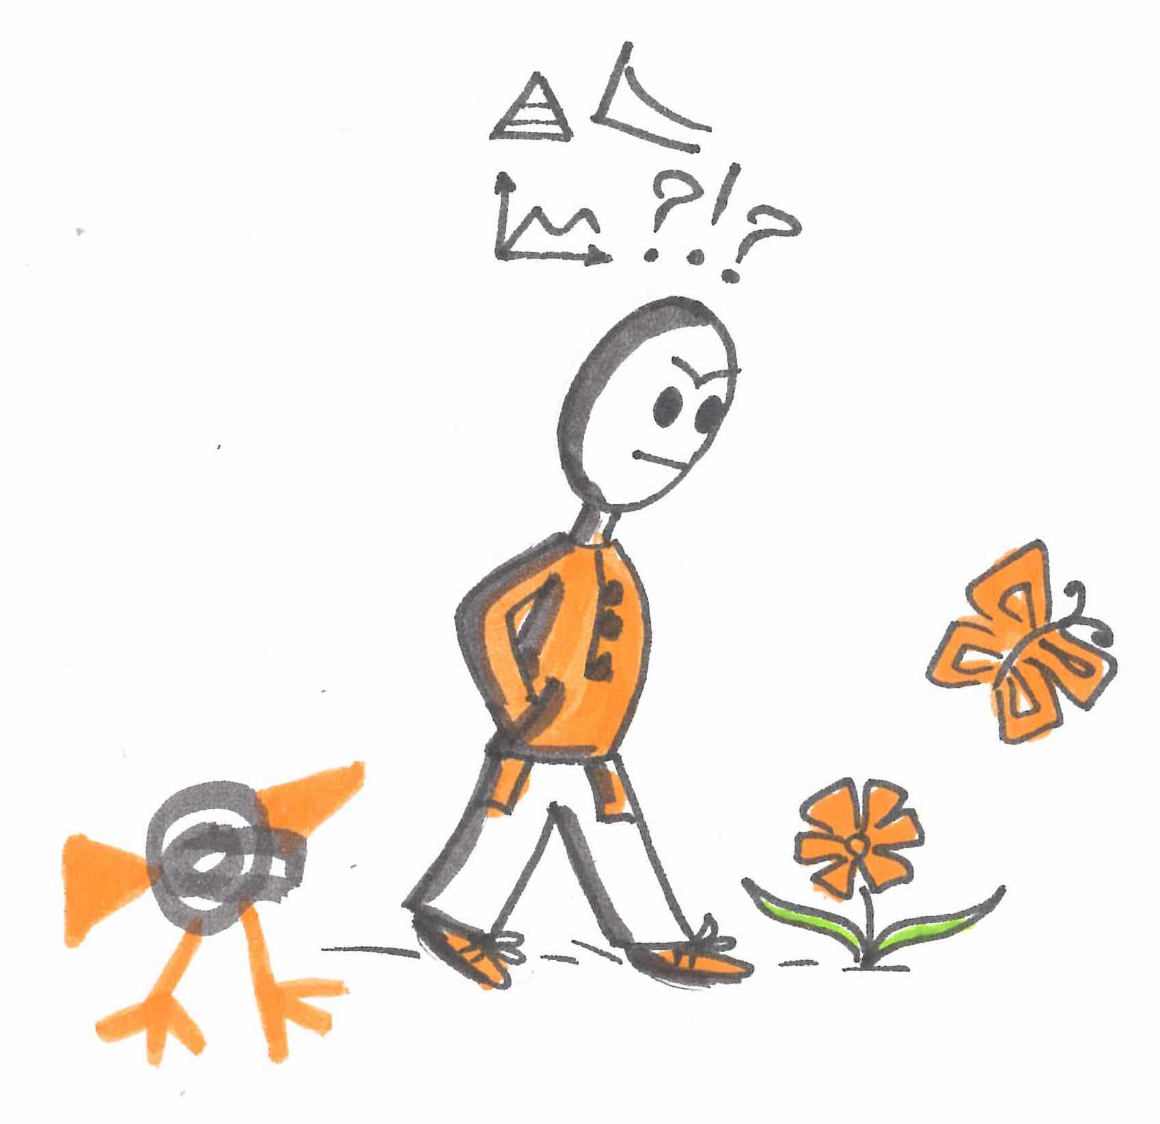

Know your audience
You are presumably the expert for this talk
Not everyone will be an expert - even at a technical conference
You want to ensure everyone will understand you and will care about what you are presenting
Notes:
Again, Reza also mentions that

Slide 9
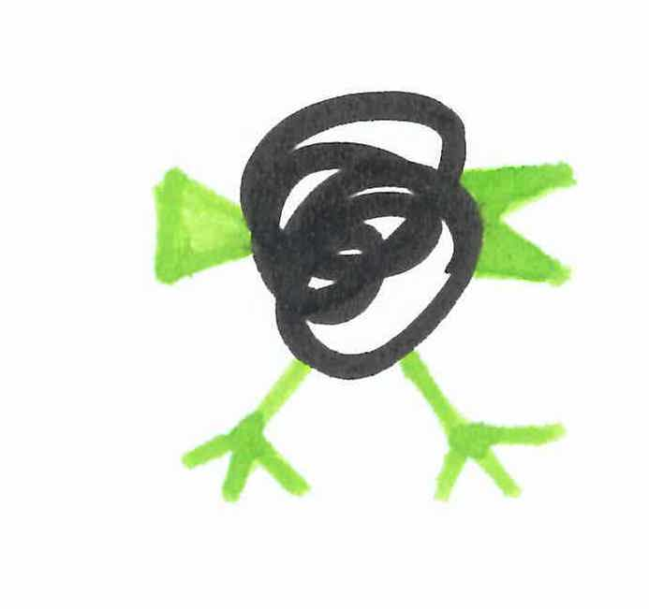
Basics and commonalities: what we can’t say enough!
Prepare - Prepare - Prepare…
Know what you are talking about
Make a story out of what you want to convey
Everything you say must be related to that story
Be careful with the use of generative AI for writing
Be aware of time or space limits - and ensure you fit into them
Notes:
Sarvnaz: I added the 3rd bullet point based on your last suggestion in the email: don’t include what does not fit the story

Slide 10

Writing *ACL papers

Slide 11
Advice
Don’t wait: Write
Identify your key idea
Tell a story
Highlight your contributions
Related Work: Later
Put your readers first
Listen to your readers
Language and Style
Use of GenAI
Paper Types
Other Advice!
Acknowledgments
Throughout this part, some slides are adapted from Dr Simon Peyton Jones and Prof Guilin Qi; we are thankful to them.

Slide 12
Writing Papers: Model
Idea
Do Research
Write Paper
Notes:
Covert to

Slide 13
Writing Papers: Model
Idea
Do Research
Write Paper
Idea
Write Paper
Do Research
Notes:
Covert to

Slide 14
Writing Papers: Model
Idea
Do Research
Write Paper
Idea
Write Paper
Do Research
Writing papers is a primary mechanism for doing research (not just for reporting it)
Forces us to be clear and focused
Crystallises what we don’t understand
Facilitates collaboration and getting feedback from others
Some people may use slides to ‘write/describe’ the initial structure of the work
Notes:
Could be slides instead of overleaf

Slide 15
Advice
Don’t wait: Write
Identify your key idea
Tell a story
Highlight your contributions
Related Work: Later
Put your readers first
Listen to your readers
Language and Style
Use of GenAI
Paper Types
Other Advice!

Slide 16
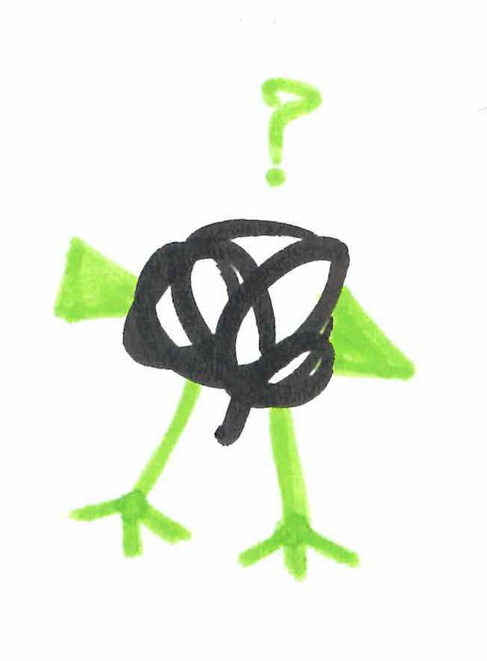
Papers Communicate Ideas
The goal is to infect the mind of your reader with your idea
The greatest ideas are worthless if you keep them to yourself
Motivate your idea!
Why it’s important? Why people should care?
Clearly formulate your research questions (RQs)
To enable drawing interesting conclusions
Your ideas to address those RQs
Proper evaluation setup, experiments, and evidence
Notes:
Example: KV caching

Slide 17
Papers Communicate Ideas
Fallacy: You need a fantastic idea before you can write a paper
Write a paper about your little idea and discuss it with your supervisor/peers
Usually it’s expanded to a bigger & more interesting idea
Your paper should have just one clear idea
If you have lots of ideas, write multiple papers
Many papers contain good ideas, but do not distil what they are
Make sure the reader is in no doubt what the idea is and be explicit about it
“The main idea of the paper is…”
“In this section, we present the main contribution of the paper..”
Notes:
Add examples?

Slide 18
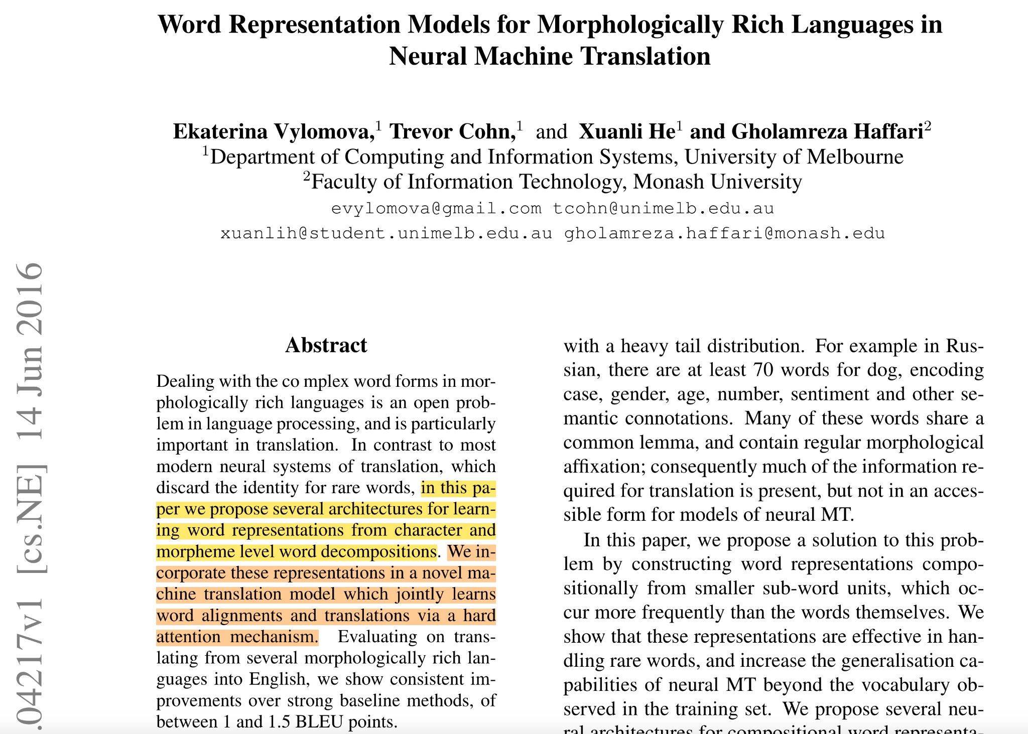
Just One Clear Idea!
Notes:
Add examples?

Slide 19
Advice
Don’t wait: Write
Identify your key idea
Tell a story
Highlight your contributions
Related Work: Later
Put your readers first
Listen to your readers
Language and Style
Use of GenAI
Paper Types
Other Advice!

Slide 20

Tell a Story
Imagine you are explaining at a whiteboard
Here is a problem
It’s an interesting problem
It’s an unsolved problem
Here is my idea
My idea works (detailed empirical analysis)
Here’s how my idea compares to other people’s approaches

Slide 21
Structure (Method Paper)
Title (1000 readers)
Abstract (1 paragraph, 100 readers)
Introduction (1 page, 100 readers)
My Approach & Idea to the Problem (2-3 pages, 10 readers)
The Details & Experiments (2-3 pages, 5 readers)
Related Work (1 page, 10 readers)
Conclusions (0.3 pages, 100 readers)
Ethics/Limitations/Social Impact (0.5 pages, 100 readers)
Notes:
Limitations: people would like to know ideas for future work

Slide 22
Advice
Don’t wait: Write
Identify your key idea
Tell a story
Highlight your contributions
Related Work: Later
Put your readers first
Listen to your readers
Language and Style
Use of GenAI
Paper Types
Other Advice!

Slide 23
Structure (Method Paper)
Title (1000 readers)
Abstract (1 paragraph, 100 readers)
Introduction (1 page, 100 readers)
My Approach & Idea to the Problem (2-3 pages, 10 readers)
The Details & Experiments (2-3 pages, 5 readers)
Related Work (1 page, 10 readers)
Conclusions (0.3 pages, 100 readers)
Ethics/Limitations/Social Impact (0.5 pages, 100 readers)
Notes:
Limitations: people would like to know ideas for future work

Slide 24
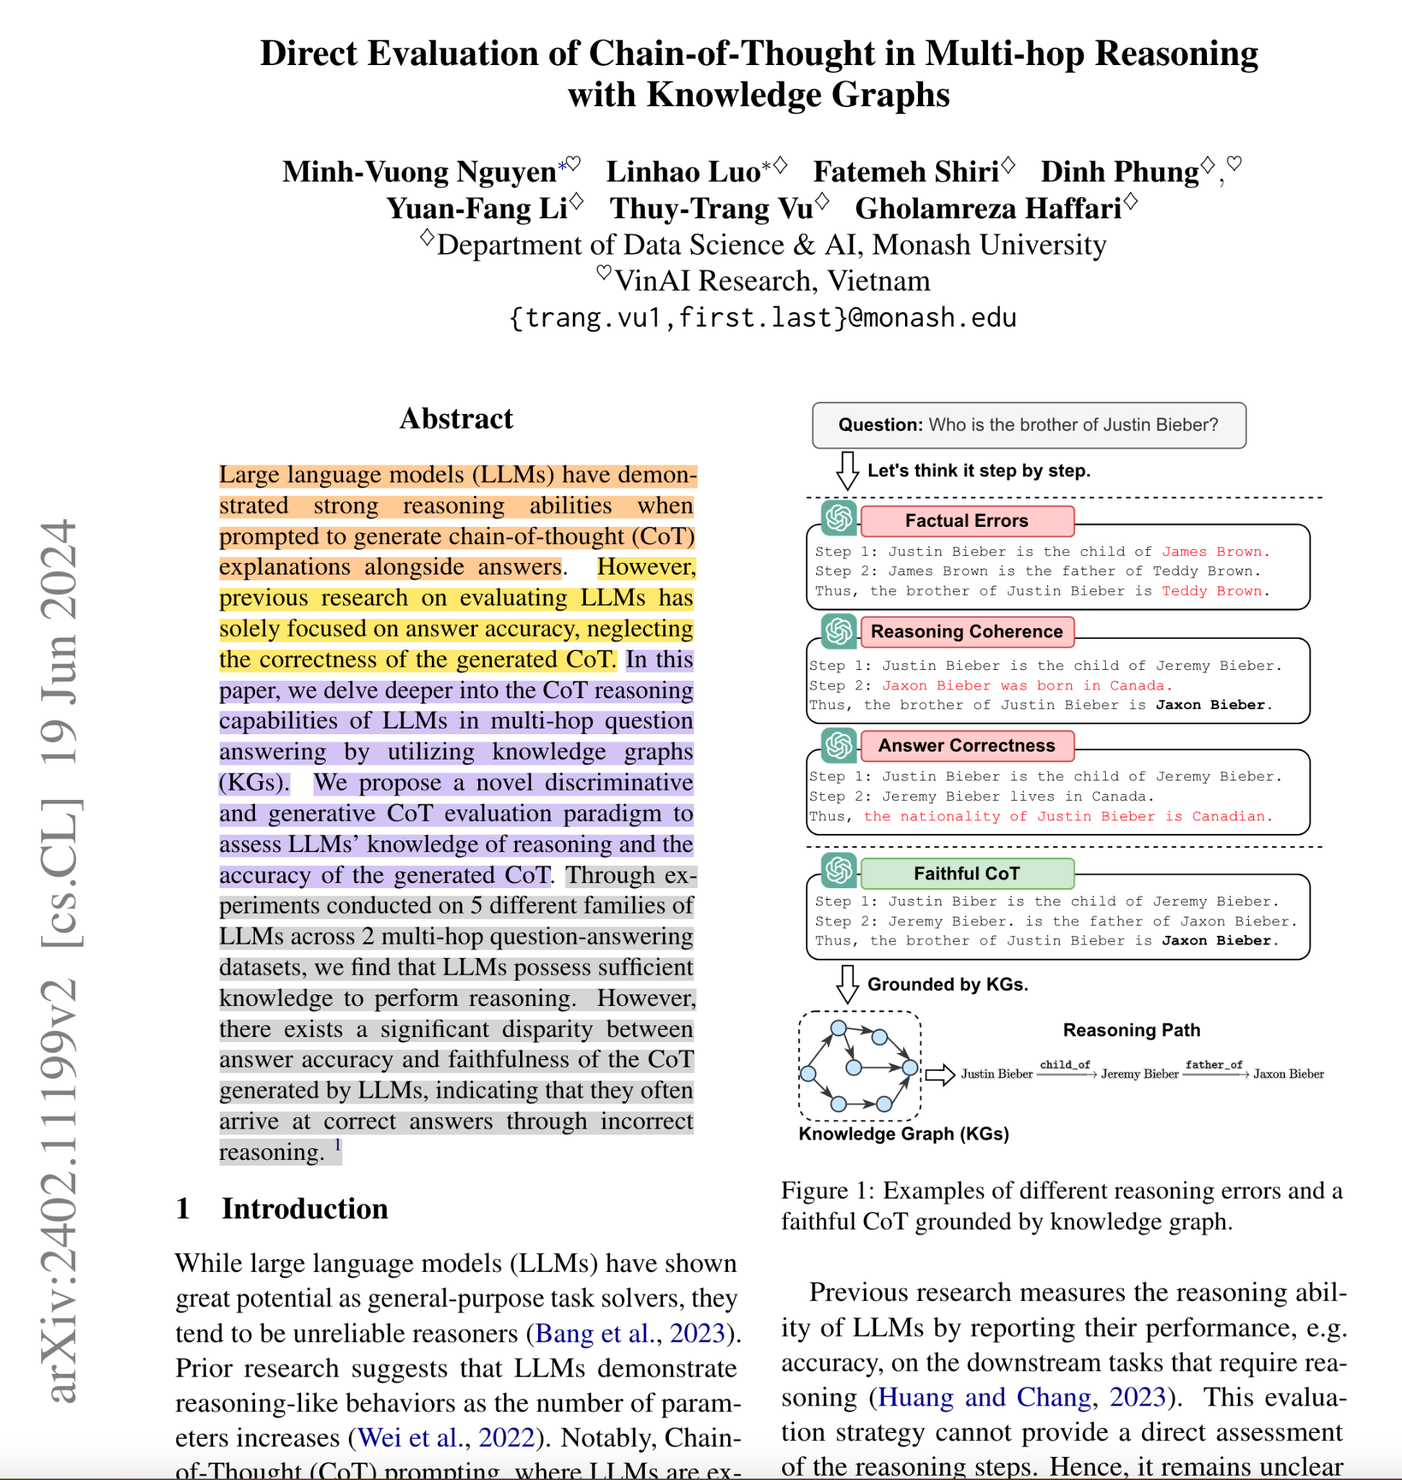
The Introduction/Abstract
Describe the problem clearly and state your contributions
Fit the Introduction into 1 page!
Write the list of contributions first
It drives the paper
The reader thinks “if they can really deliver this, that’s exciting; I’d better read on”
Notes:
Add example?
Add template for paragraphs

Slide 25
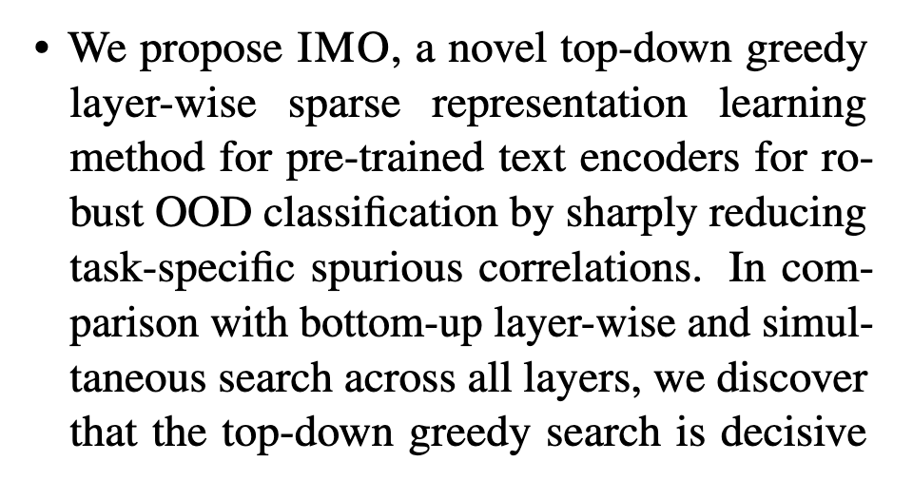
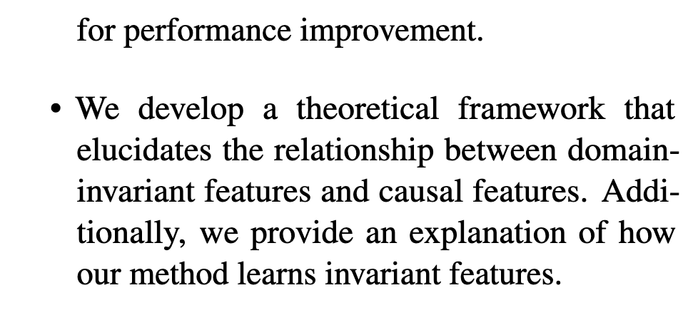
The Introduction/Abstract
Describe the problem clearly and state your contributions
Fit the Introduction into 1 page!
Write the list of contributions first
It drives the paper
The reader thinks “if they can really deliver this, that’s exciting; I’d better read on”
Notes:
Add examples?

Slide 26
Contributions Should be Refutable
Your Introduction makes claims
The body of the paper provides evidence to support each claim
Don’t overstate your contributions!
Check each claim in the introduction
Identify the evidence, and forward-reference it
Evidence
It can be analysis and comparisons, theorems, case studies, etc
Notes:
Add examples?
Overstate (LLMs)

Slide 27

No “rest of this paper is…”
Not:
“The rest of this paper of structured as follows. Section 2 introduces the problem. Section 3…”
Instead:
The introduction (including the contributions) should survey the whole paper, thus forward reference every important part
I revise the “Introduction” and “Abstract” at the very end
After finalising: “Problem/Approach”, “Experiments”, “Related Works”

Slide 28
Advice
Don’t wait: Write
Identify your key idea
Tell a story
Highlight your contributions
Related Work: Later
Put your readers first
Listen to your readers
Language and Style
Use of GenAI
Paper Types
Other Advice!

Slide 29
Structure (Conference Papers)
Title (1000 readers)
Abstract (1 paragraph, 100 readers)
Introduction (1 page, 100 readers)
Related Work (1 page, 10 readers)
My Approach & Idea to the Problem (2-3 pages, 10 readers)
The Details & Experiments (2-3 pages, 5 readers)
Conclusions (.3 pages, 100 readers)
Ethics/Limitations/Social Impact (.5 pages, 100 readers)
NO
Notes:
Limitations: people would like to know ideas for future work

Slide 30
Structure (Conference Papers)
Title (1000 readers)
Abstract (1 paragraph, 100 readers)
Introduction (1 page, 100 readers)
My Approach & Idea to the Problem (2-3 pages, 10 readers)
The Details & Experiments (2-3 pages, 5 readers)
Related Work (1 page, 10 readers)
Conclusions (.3 pages, 100 readers)
Ethics/Limitations/Social Impact (.5 pages, 100 readers)
YES
Notes:
- what makes it specific to ACL - analysis
- spend some time on ethics and limitation and social impact

Slide 31
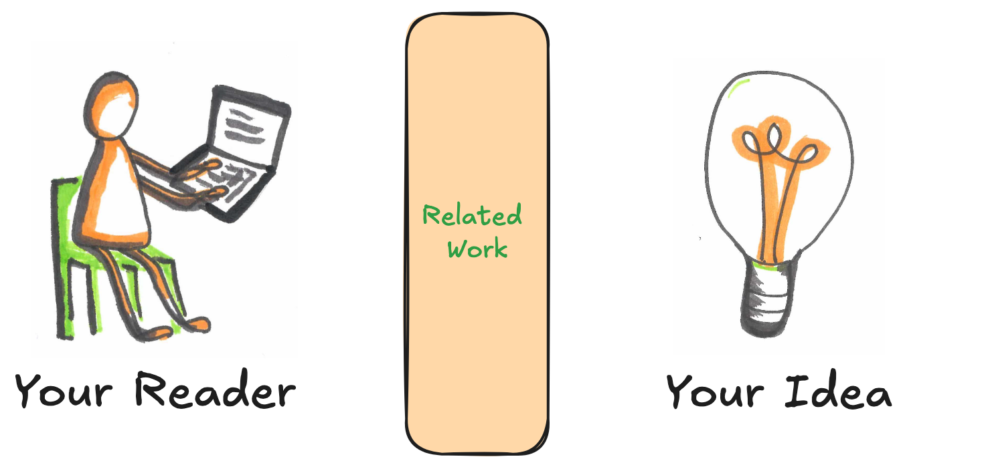
Gets Between the Reader and Your Idea!
Notes:
As a reader, i skip the related work and read the main section

Slide 32
Hard to Understand for the Reader
The reader know nothing about the problem yet!
So your (highly compressed) description of various technical tradeoffs is incomprehensible!
But need to situate the work early in the paper
I usually have a paragraph in the Introduction
More detailed literature coverage is done in the Related Work section

Slide 33
Credit
Fallacy: To make my work look good, I have to make other people’s work look bad
Not the right & helpful approach!
Warmly acknowledge
Previous/Current work related to or is the basis of your work
People who have helped you
Weakness/Limitation in your approach compared to others

Slide 34
Advice
Don’t wait: Write
Identify your key idea
Tell a story
Highlight your contributions
Related Work: Later
Put your readers first
Listen to your readers
Language and Style
Use of GenAI
Paper Types
Other Advice!

Slide 35
Structure (Method Paper)
Title (1000 readers)
Abstract (1 paragraph, 100 readers)
Introduction (1 page, 100 readers)
My Approach & Idea to the Problem (2-3 pages, 10 readers)
The Details & Experiments (2-3 pages, 5 readers)
Related Work (1 page, 10 readers)
Conclusions (0.3 pages, 100 readers)
Ethics/Limitations/Social Impact (0.5 pages, 100 readers)
Notes:
Limitations: people would like to know ideas for future work

Slide 36
Putting The Readers First
Do not present your personal journey of discovery!
This becomes part of you and forms the way you think about the project
Detach yourself and instead think how it can be best explained to others
Choose the most direct route to the idea
It’s like linearising the 3D structure of DNA into a sequence (cf: Jason Eisner)
B
B
A
A
Notes:
Add examples?

Slide 37
Presenting the Idea
Explain it as if you were speaking to someone using a whiteboard
Convey the intuitions
It’s the primary goal, not the secondary!
Once the reader gets the intuitions, they can follow the details (not vice versa)
Conveying the intuition can be best done by examples!
Present the general case afterwards
Notes:
Add examples?

Slide 38
Structure (Method Paper)
Title (1000 readers)
Abstract (1 paragraph, 100 readers)
Introduction (1 page, 100 readers)
My Approach & Idea to the Problem (2-3 pages, 10 readers)
The Details & Experiments (2-3 pages, 5 readers)
Related Work (1 page, 10 readers)
Conclusions (0.3 pages, 100 readers)
Ethics/Limitations/Social Impact (0.5 pages, 100 readers)
Notes:
Limitations: people would like to know ideas for future work

Slide 39

Ethics/Limitations/Social Impact
Adhere to the ethics guidelines of ACL as well as your workplace
Particularly important when involving human, e.g., data annotation, evaluation
For example, research that involves working with harmful content
Limitations
Genuinely mention the limitations of your work and what could have been done
Helpful for others to do follow up on your research
Helpful to you as your work gets noticed and cited more
Social Impact
The impact of NLP on users’ lives
Exclusion, Overgeneralisation, Exposure
Notes:
Ethics: the time exposed to harmful material

Slide 40
Advice
Don’t wait: Write
Identify your key idea
Tell a story
Highlight your contributions
Related Work: Later
Put your readers first
Listen to your readers
Language and Style
Use of GenAI
Paper Types
Other Advice!

Slide 41
Getting Help from Peers
Get your paper read by as many colleagues/peers as possible
Both experts and non-experts!
Each reader most probably can read your paper only once
So use them wisely!
Explain carefully the kind of feedback you want
For example, logic-level vs English, etc

Slide 42
Listening to Your Reviewers
Treat reviews very valuable!
Be (truly) grateful for criticism & praise
This is very hard but very important!
Occasionally there may be non-useful reviews as well, don’t get discouraged! You may escalate to the ACs!
Take criticism as a positive suggestion for something you could do better
Perceive as constructive feedback!
Better explanation, better experimental setup and evaluation, better analysis
Rebuttal
Thank the reviews warmly; they give up their time for you!
Objectively address as many comments as possible
Don’t take it personal, the goal is to improve the work

Slide 43
Advice
Don’t wait: Write
Identify your key idea
Tell a story
Highlight your contributions
Related Work: Later
Put your readers first
Listen to your readers
Language and Style
Use of GenAI
Paper Types
Other Advice!

Slide 44
Basic Points
Submit by the deadline!
Adhere to the guidelines
Keep to the length restrictions
Don’t change the margin, font size, line space, etc
Make use of the appendix
To provide more supporting evidence, results, examples, etc
Always use a spell checker!

Slide 45

Use the Active Voice!
The passive voice is respectable but it deadens your paper!
Don’t | Do
It can be seen that.. | We can see that..
35 tests were run | We ran 35 tests
These properties were thought desirable | We wanted to retain these properties
It might be thought that this would be a type of error | You might think this is a type of error
Notes:
Cultural aspect
As reviewer, why?

Slide 46
Use Simple Direct Language
Don’t | Do
The object under study was displaced horizontally | The ball moved sideways
Endeavour to ascertain | Find out
On annual basis | Yearly
It could be considered that the speed of storage reclamation left something to be desired | The garbage collector was slow

Slide 47
Visual Structure
Give a nice visual structure to your paper
Sections and subsections, bullets, italics, etc
The place of the tables and figures
Simplified tables and charts
Find out how to draw nice figures and use them!
Notes:
Add examples?

Slide 48
Constant Revisions
Constantly rereading & thinking from the perspective of a reader
Are these terms & acronyms defined properly
Are the uses of anaphora & pronouns clear
Is there a consistent tense and style
Are the figures and tables clearly explained
Make sure the data/code is noticeable by the reviewers/readers
Making code/data available is highly recommended
You may upload them to the submission website but they may not get noticed!
Make sure you point out code/data explicitly in the paper, e.g., Abstract/Intro
Have a checklist before the submission and double check them
Notes:
Forward referecne to Sarvnaz

Slide 49
Advice
Don’t wait: Write
Identify your key idea
Tell a story
Highlight your contributions
Related Work: Later
Put your readers first
Listen to your readers
Language and Style
Use of GenAI
Paper Types
Other Advice!

Slide 50
Use of GenAI and LLMs
“Defensive Writing”: Avoid obvious gaps that can be picked up by “Reviewer 2”
Example query in ChatGPT Consider reviewing for an AI conference, such as NAACL, ICLR or ICCV. Authors complain about reviewers who give simple general phrases that can be hard to rebut and can be applied to just about anything: "you need more data for evaluation", "the description of the algorithm is imprecise", "you haven't cited recent literature", "you need comparisons with more recent algorithms", ... Can you list a number of these phrases?
This gives a good checklist of things to double check against
Beware of LLMs’ hallucinations and non-up-to-date knowledge
Don’t rely on them for “Related Work”
Adhere to ACL guidelines for the use of GenAI
Watch out for this space
Notes:
Adhere to ACL guidelines about the use of GenAI, (will be announced soon; watch for) Reviewr2 is the 'metaphore' for that unreasonale reviewer amot the three reviewers :)

Slide 51
Advice
Don’t wait: Write
Identify your key idea
Tell a story
Highlight your contributions
Related Work: Later
Put your readers first
Listen to your readers
Language and Style
Use of GenAI
Paper Types
Other Advice!

Slide 52
Types of papers
Methodology paper: new methods (models or frameworks)
Analysis paper: comprehensive evaluation of existing methods
Data paper: new datasets or benchmarks, possibly with new tasks and a simple method
Survey paper: summary of recent work in a field or a task
For different types of papers the writing of the paper will be different, let’s consider abstract and introduction to illustrate this
52

Slide 53
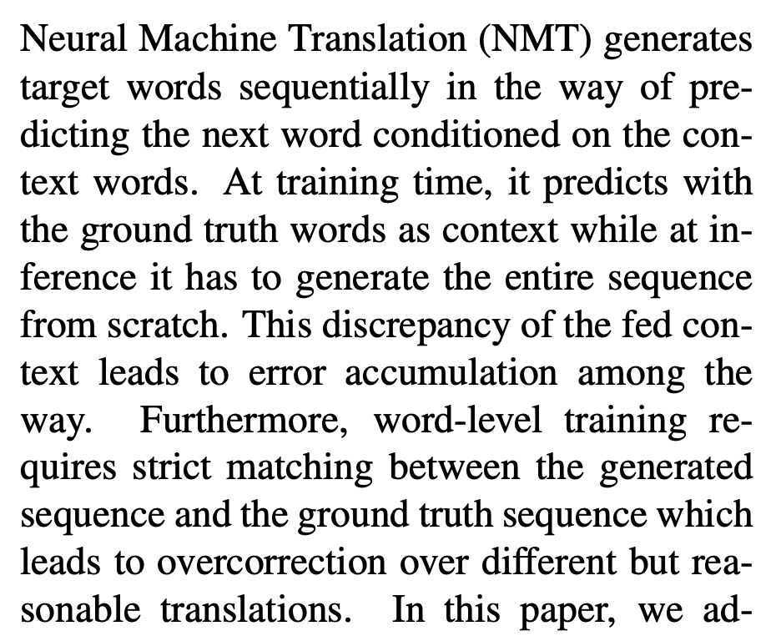
Methodology Papers
ACL 2019 Best paper
One sentence to summarise task
Abstract
First Challenge
Second Challenge
Zhang W, Feng Y, Meng F, et al. Bridging the gap between training and inference for neural machine translation[J]. arXiv preprint arXiv:1906.02448, 2019.
53

Slide 54
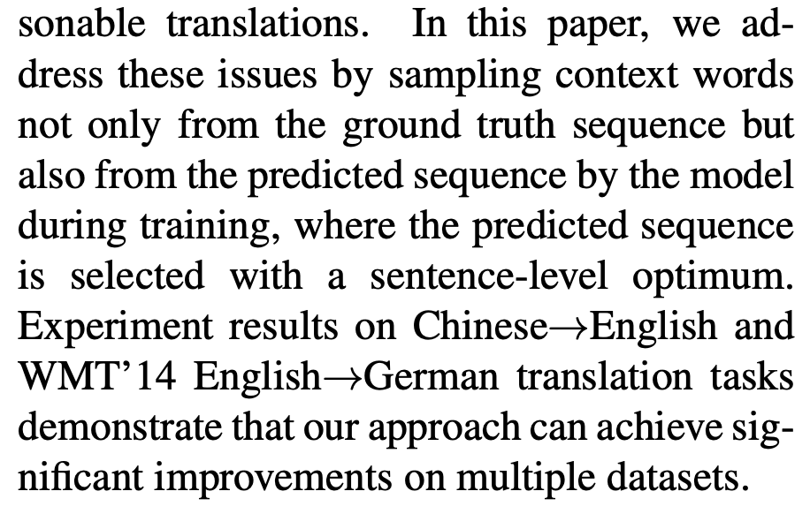
Methodology Papers
ACL 2019 Best paper
Abstract
Method summarisation
Experimental results
Zhang W, Feng Y, Meng F, et al. Bridging the gap between training and inference for neural machine translation[J]. arXiv preprint arXiv:1906.02448, 2019.
54

Slide 55
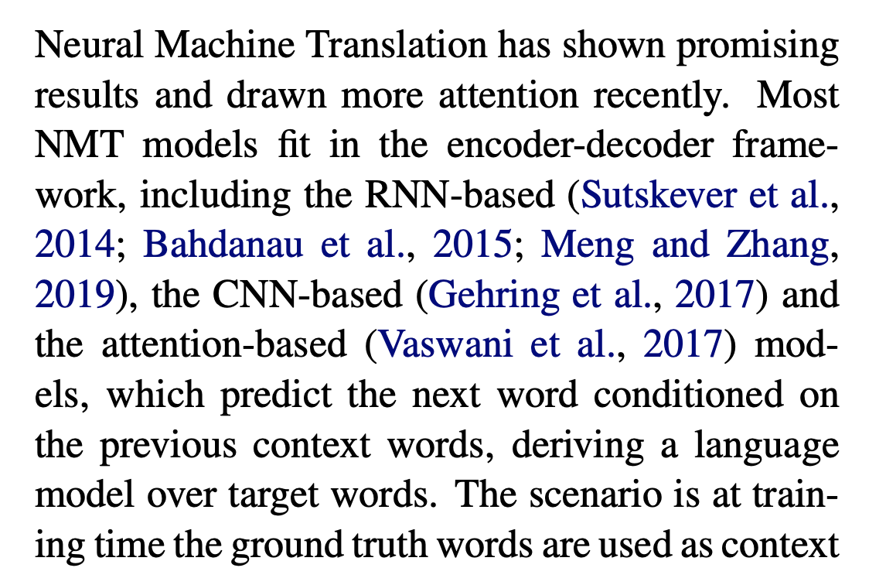
Methodology Papers
ACL 2019 Best paper
Starting with the introduction of the task and its value, then short summary of existing methods
Introduction
Zhang W, Feng Y, Meng F, et al. Bridging the gap between training and inference for neural machine translation[J]. arXiv preprint arXiv:1906.02448, 2019.
55

Slide 56
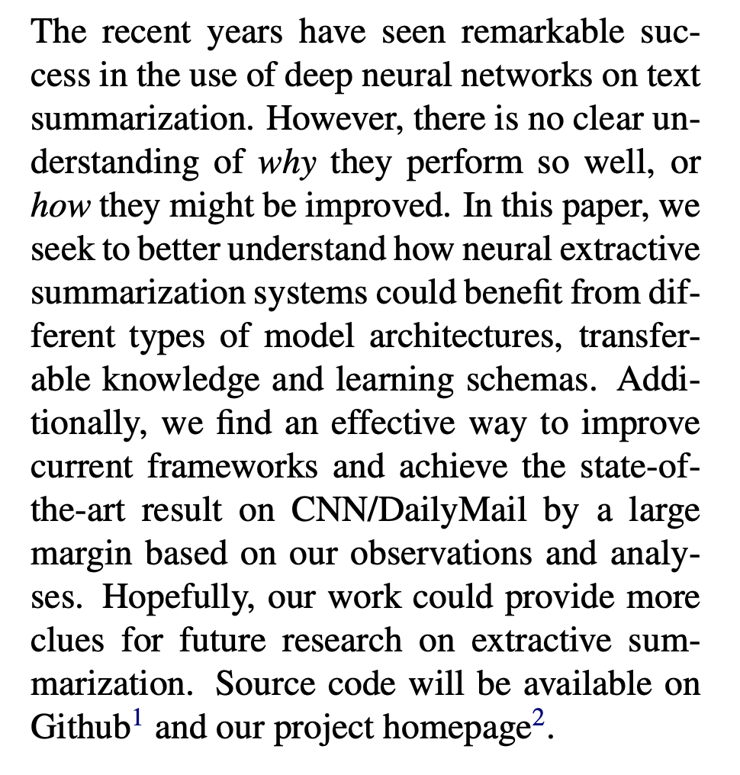
Analysis Paper-Example
ACL 2019 Paper on neural extractive summarisation
Task and background
Research gap in existing work, namely the aspects that have not been evaluated and analysed.
Abstract
Key aspects to analyse
Significance of the analysis
Zhong M, Liu P, Wang D, et al. Searching for Effective Neural Extractive Summarization: What Works and What’s Next[C]//Proceedings of the 57th Annual Meeting of the Association for Computational Linguistics. 2019: 1049-1058.
56

Slide 57
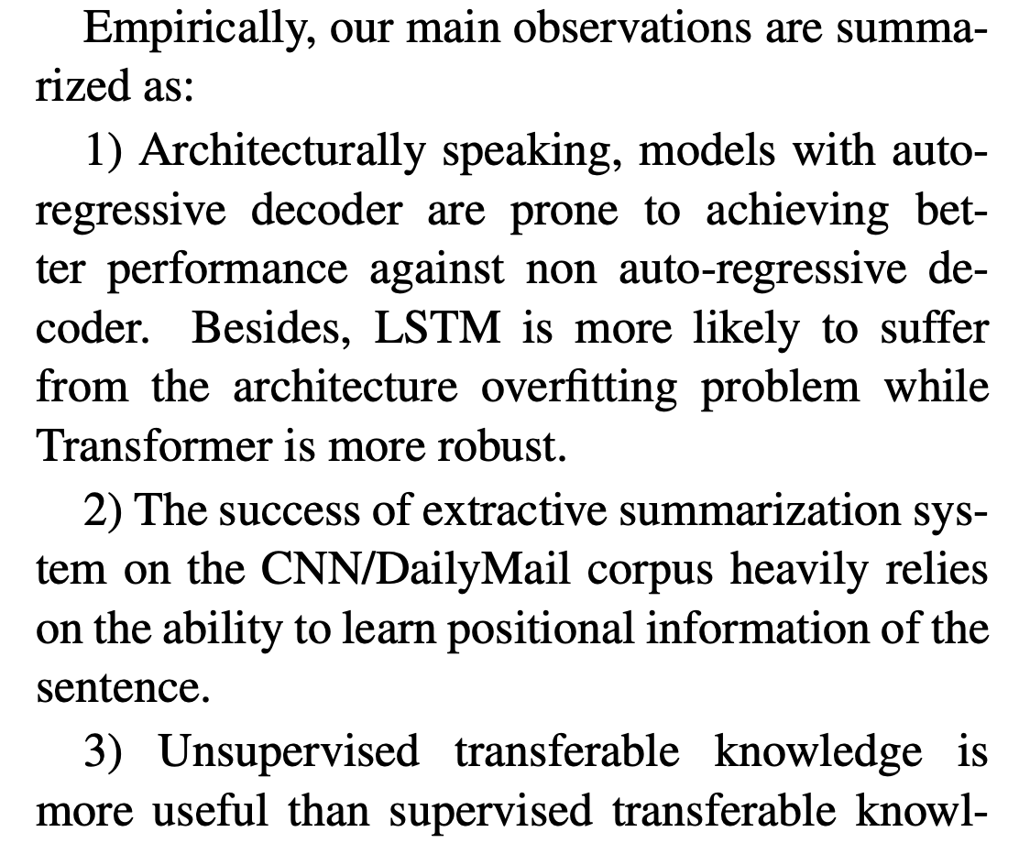
Analysis Paper-Example
ACL 2019 Paper on neural extractive summarisation
Analytical papers generally do not discuss method contributions, but rather present observations; summarise the conclusions derived from the experiments.
Introduction
Zhong M, Liu P, Wang D, et al. Searching for Effective Neural Extractive Summarization: What Works and What’s Next[C]//Proceedings of the 57th Annual Meeting of the Association for Computational Linguistics. 2019: 1049-1058.
57

Slide 58
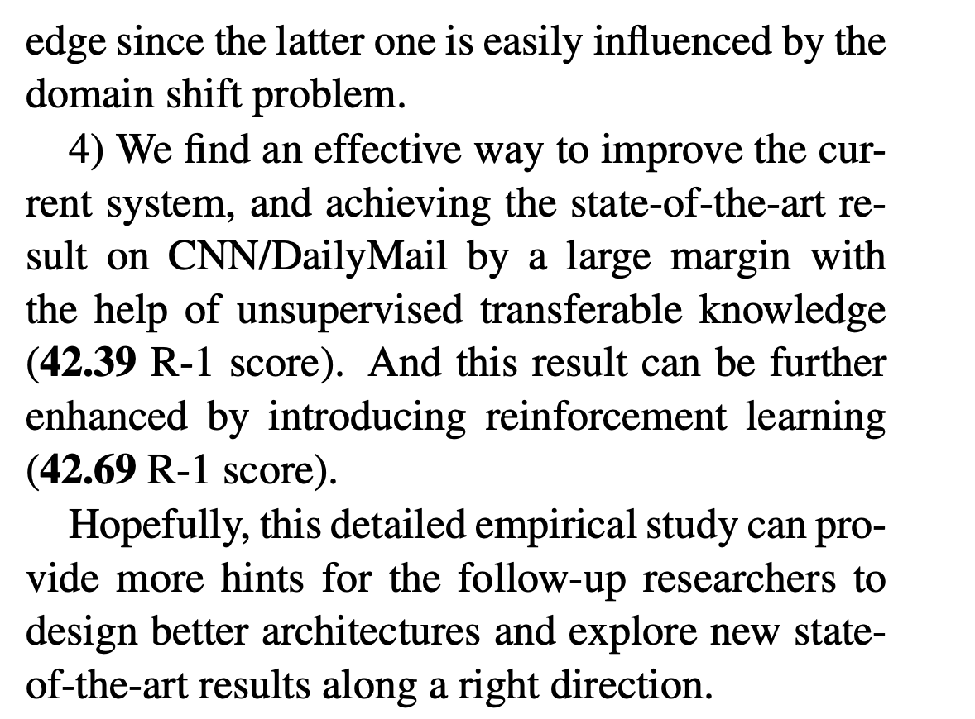
Analysis Paper-Example
ACL 2019 Paper on neural extractive summarisation
Some analytical work involves proposing a very simple improvement strategy based on observations, further enhancing the contribution of the paper.
Introduction
Zhong M, Liu P, Wang D, et al. Searching for Effective Neural Extractive Summarization: What Works and What’s Next[C]//Proceedings of the 57th Annual Meeting of the Association for Computational Linguistics. 2019: 1049-1058.
58

Slide 59
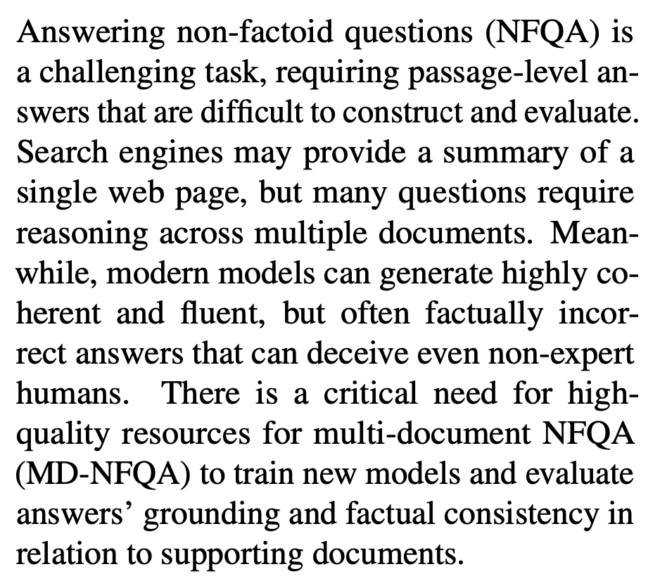
Data Paper-Example
ACL 2023 Paper on non-factoid question answering
One sentence to summarise task
Abstract
Challenges
Gap of existing benchmark
Bolotova-Baranova V, Blinov V, Filippova S, et al. WikiHowQA: A comprehensive benchmark for multi-document non-factoid question answering[C]//Proceedings of the 61st Annual Meeting of the Association for Computational Linguistics (Volume 1: Long Papers). 2023: 5291-5314.
59

Slide 60
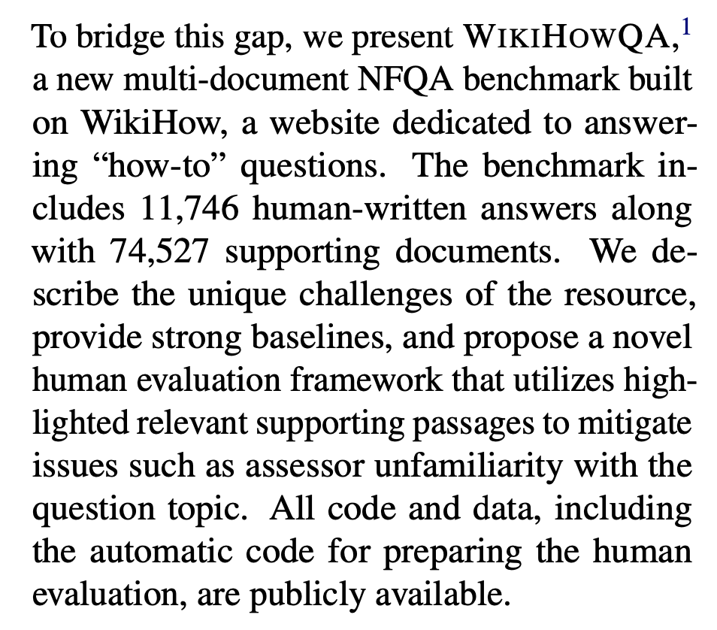
Data Paper-Example
ACL 2023 Paper on non-factoid question answering
Briefly summarise the name of the dataset, data statistics, and its characteristics.
Abstract
Bolotova-Baranova V, Blinov V, Filippova S, et al. WikiHowQA: A comprehensive benchmark for multi-document non-factoid question answering[C]//Proceedings of the 61st Annual Meeting of the Association for Computational Linguistics (Volume 1: Long Papers). 2023: 5291-5314.
60

Slide 61
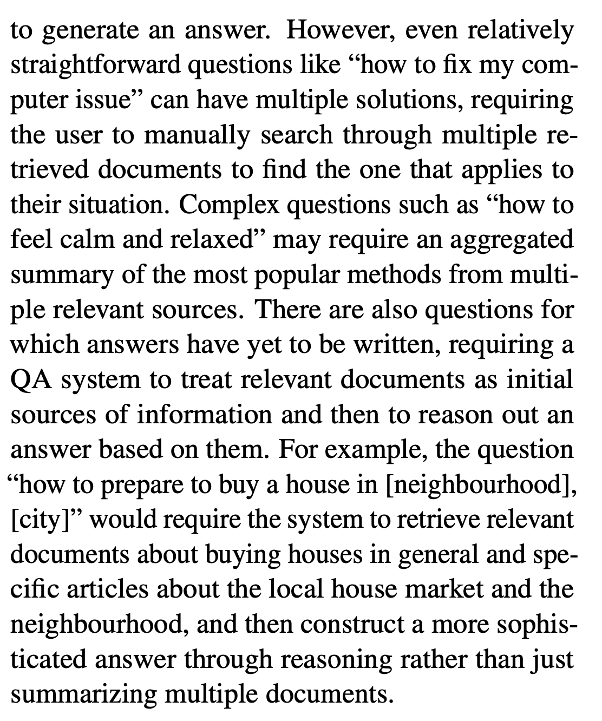
Data Paper-Example
ACL 2023 Paper on non-factoid question answering
Mention the difficulties and challenges involved in completing this dataset to further highlight the contributions.
Introduction
Bolotova-Baranova V, Blinov V, Filippova S, et al. WikiHowQA: A comprehensive benchmark for multi-document non-factoid question answering[C]//Proceedings of the 61st Annual Meeting of the Association for Computational Linguistics (Volume 1: Long Papers). 2023: 5291-5314.
61

Slide 62
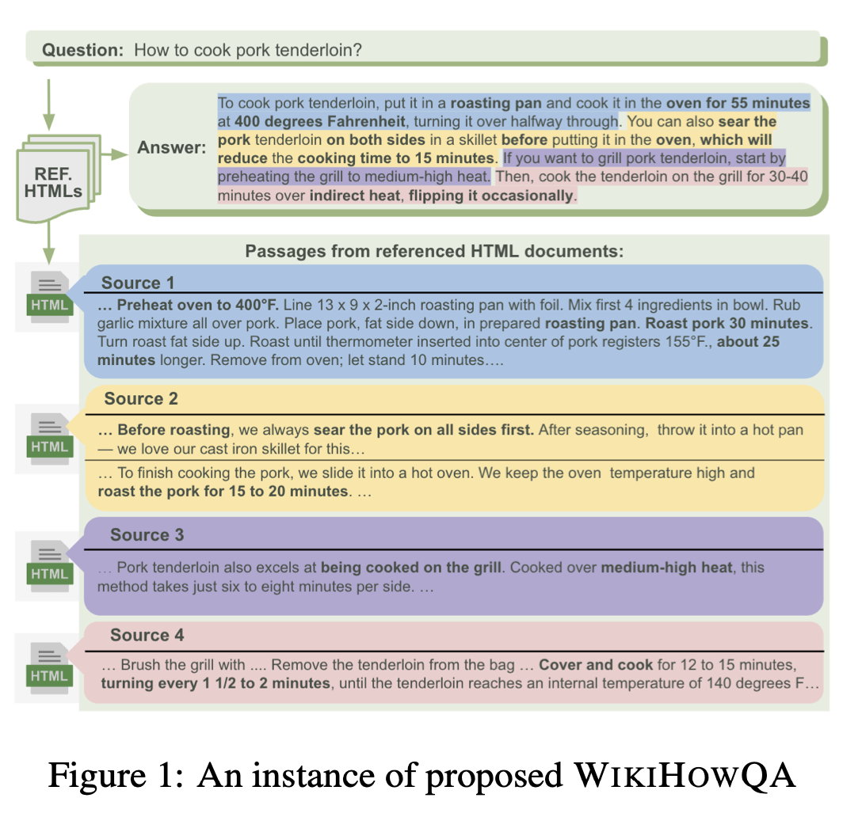
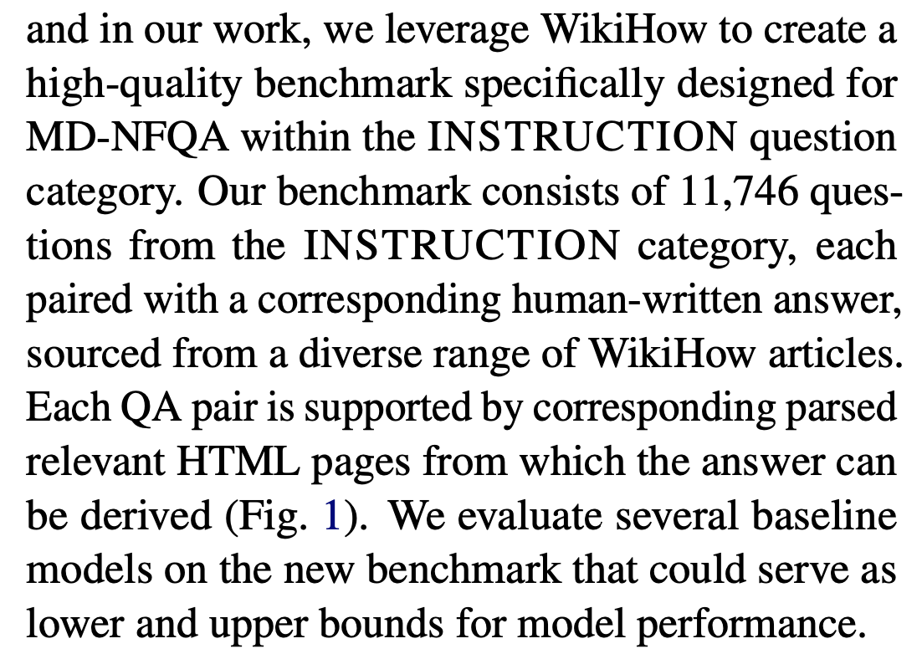
Data Paper-Example
ACL 2023 Paper on non-factoid question answering
Introduce the statistical data of the new benchmark. Highlight the challenges.
Use a figure to describe the format of the dataset (task).
Introduction
Bolotova-Baranova V, Blinov V, Filippova S, et al. WikiHowQA: A comprehensive benchmark for multi-document non-factoid question answering[C]//Proceedings of the 61st Annual Meeting of the Association for Computational Linguistics (Volume 1: Long Papers). 2023: 5291-5314.
62

Slide 63
Advice
Don’t wait: Write
Identify your key idea
Tell a story
Highlight your contributions
Related Work: Later
Put your readers first
Listen to your readers
Language and Style
Use of GenAI
Paper Types
Other Advice!

Slide 64
Know the Audience: Write for Different Audience Groups
Audience Group A
Reach research specialists, immediate colleagues, the 20-50 other people in the world who know a lot about the topic
Their feedback helps strengthening the work
Audience Group B
The "knowledgeable", the other 200-1000 who would like to know more so need some support while reading
Reach this second group if they want high citations

Slide 65
Well-being
You need to get a break from writing to take you mind completely off it
Come back in later with a fresh perspective
A walk in nature, a cold shower, a day trip away, a relaxing evening followed by a good night's sleep, etc
Sleep and the subconscious mind are great at resolving problems
Think carefully about the problem, then walk away from it and come back later
Never sit for too long writing, the mind just slows down
Make an initial submission well-before the deadline!
Keep revising and resubmitting
Helps your well-being! (avoid short-time submission stress)
Notes:
Get the paper done and submitted as early as possible, take your time off later

Slide 66
Take Home Messages!
Practice, practice, practice!
Get your supervisors/peers to review your writing
Learn from the feedback (backprop the difference in your neural net)
Get the content down, ignoring fancy writing
Best done with bullets
Try and do all the major experimental work ahead of time
But expect to need to do a bunch of additional things later on
Adhere to the submission guidelines
Use simple, clear, and direct language with a nice visual structure
Important: Choose the right track when submitting to get the right reviewers
Notes:
Appendix is not the solution, all important things should be in the 8 pages (self-contained)
Find the code and dataset, make it clear and noticeable (anonymous link; footnote; commented code to re-run the code)
Check list in opereview
Dataset track
Choose the right primary/secondary track (enough time before the submission); make an acceptable submission and revise later

Slide 67
Oral Presentation
Narrative, structure and content
Some tips
Preparation
Presenting

Slide 68
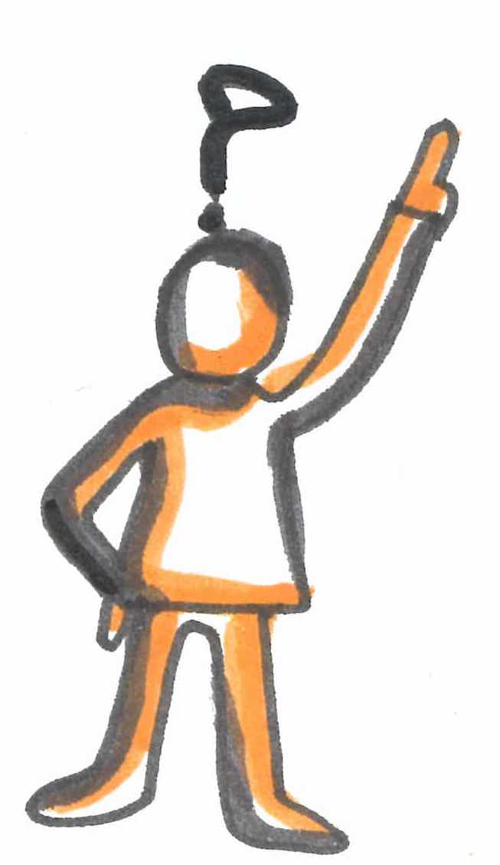
Now you know your take-home message…
Make a story of what you want to tell
Make it compelling: motivate the problem (or idea) you are addressing: you want to capture your audience
Make the aims of your talk clear at the outset
Slides should then follow your narrative and structure

Slide 69

Tips for your slides: DO’s and DON’Ts – The DO’s
Always have a separate title slide
Notes:
Notes: backup your claims: either with your results or with literature - if providing references, put them at the bottom of the slide

Slide 70
Tips for your slides: DO’s and DON’Ts – The DO’s
Always have a separate title slide
Think of the role of each of your slide
Choose your slide titles with care
Notes:
Notes: backup your claims: either with your results or with literature - if providing references, put them at the bottom of the slide

Slide 71
Tips for your slides: DO’s and DON’Ts – The DO’s
Always have a separate title slide
Think of the role of each of your slide
Choose your slide titles with care
Back up your claims
Notes:
Notes: backup your claims: either with your results or with literature - if providing references, put them at the bottom of the slide

Slide 72

Tips for your slides: DO’s and DON’Ts – The DO’s
Always have a separate title slide
Think of the role of each of your slide
Choose your slide titles with care
Back up your claims
Recap at the end of each major segment of your talk
Repeat your take-home message at the end
Notes:
Notes: backup your claims: either with your results or with literature - if providing references, put them at the bottom of the slide

Slide 73
Tips for your slides: DO’s and DON’Ts – More DO’s
Explain terms that might be unfamiliar to the audience
Be consistent

Slide 74
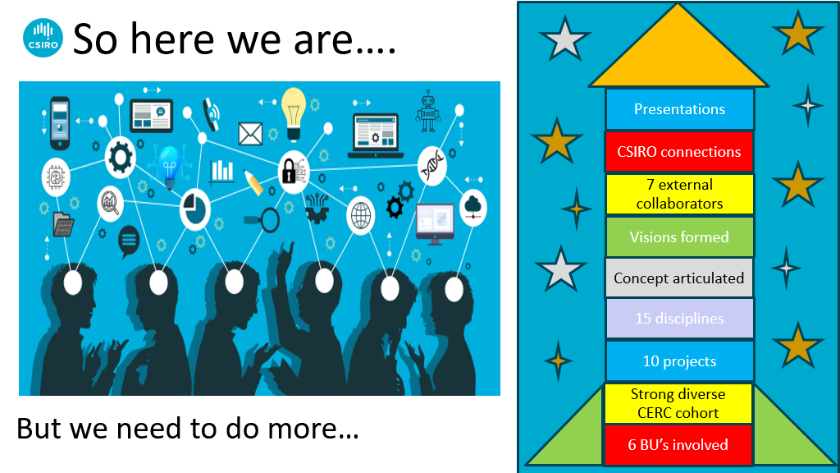
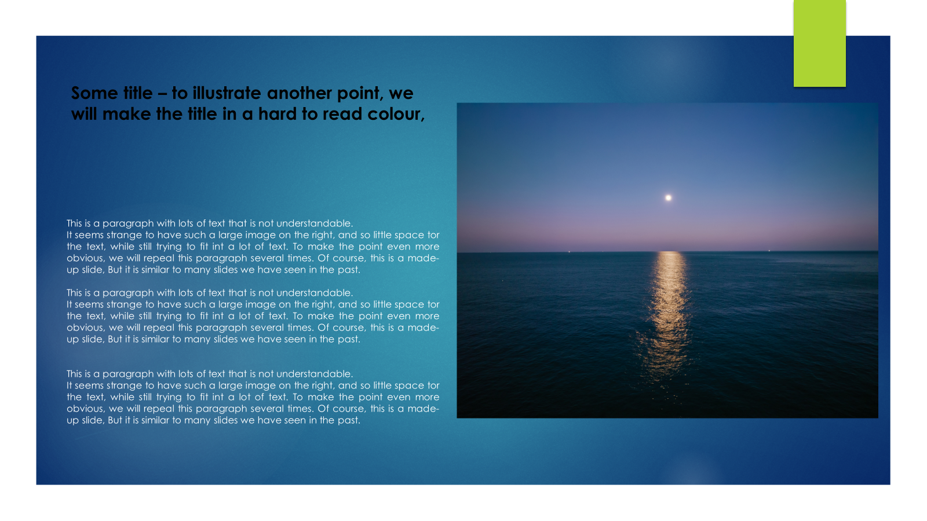
Tips for your slides: DO’s and DON’Ts – More DO’s
Explain terms that might be unfamiliar to the audience
Be consistent
Use (meaningful) examples, graphics and illustrations
Make your slides attractive
Make sure everything is readable (and understandable)
Thank collaborators

Slide 75
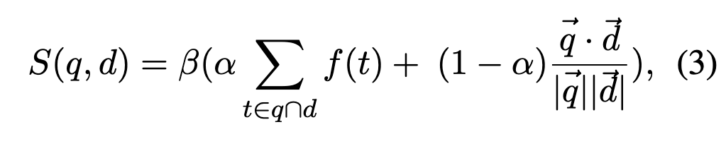
Tips for your slides: DO’s and DON’Ts – the DON’Ts
Don’t cluter the slides with too much information - it’s hard to read and listen at the same time and most people can’t do both; but they will try and the result means that they will neither listen to you correctly or read properly - as a result they will not get anything of what you say and be left baffled (or worse bored)
Avoid long sentences - it’s hard to read long sentences. Make your statement in the slides as concise as possible.
Avoid cut-and-paste from the papr (including captions for figures) - again, that’s too much text. In all likelihood, it will be too small to read and people will have no idea what you are talking about. You want your paper to be an advertisement for your paper so that people go and read the paper.
Bullet points should be consistent in their syntax.
Generally you want to avoid inconsistencies: of spelling, of terminology, of fonts, etc
Don’t provide all the details - again, you want people to read your paper. You can mention that more details are included in the paper. Again, you want your talk to be an advertisement for your paper - not the whole thing.
Don’t use colours which are hrd to see (and think of people who colour blind - There are more than you think!) [what is this saying?]
And don’t use colours just for the sake of it - people will try to attribute meaning to them
Don’t use jargon or acronyms -you will lose a lot of the audience
Don’t have a last slide which simply says “Questions?” or “Thank you” - it’s a useless slide and it’s a waste of people’s attention while they asking questions
Notes:
This is an example of what not to do - the next few slides will unpack

Slide 76
Tips for your slides: DO’s and DON’Ts – the DON’Ts
Clutter the slides with too much information
Employ long sentences or cut-and-paste from the paper
Provide all the details
Use jargon or acronyms; have a slide full of equations
Criticise prior work
Notes:
Notes:
For short talks, avoid useless outline slide : Introduction, Method, evaluation and Conclusion
One cannot read and listen at the same time
That includes cut-and-paste for captions
You want people to read your paper - you can tell people there are more details in the paper - stick to your story

Slide 77
Tips for your slides: DO’s and DON’Ts – the DON’Ts
Clutter the slides with too much information
Employ long sentences or cut-and-paste from the paper
Provide all the details
Use jargon or acronyms; have a slide full of equations
Criticise prior work
Have a last slide which simply says “Questions?” or “Thank you”
Notes:
Notes:
For short talks, avoid useless outline slide : Introduction, Method, evaluation and Conclusion
One cannot read and listen at the same time
That includes cut-and-paste for captions
You want people to read your paper - you can tell people there are more details in the paper - stick to your story

Slide 78


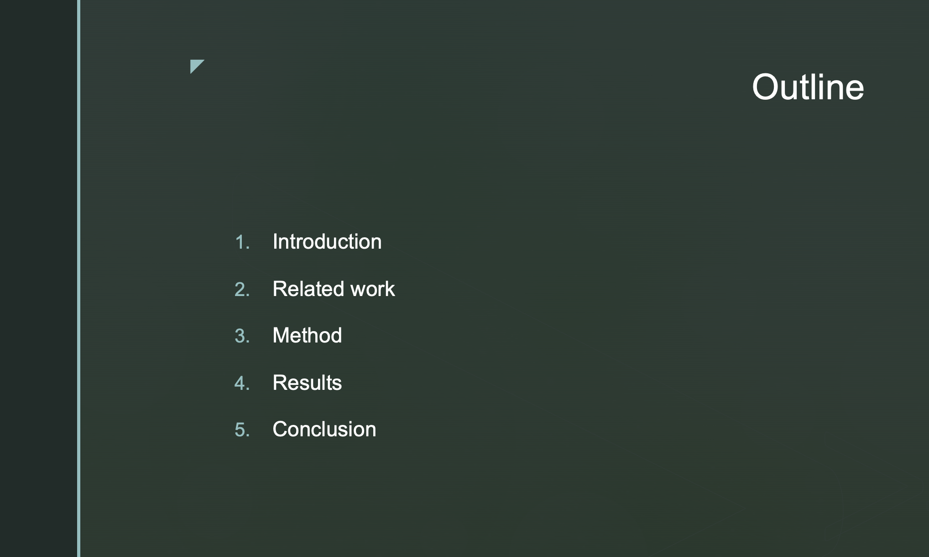

Slide 79
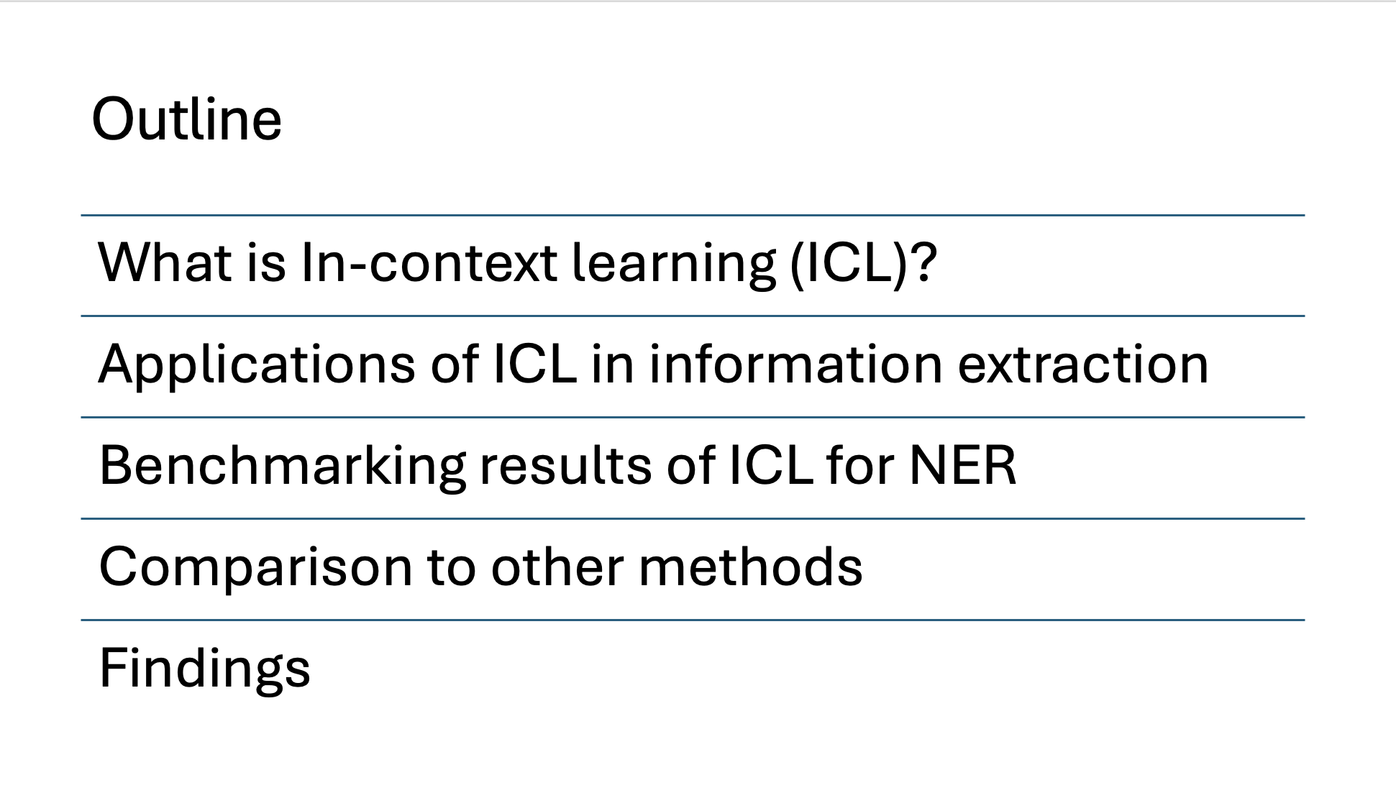
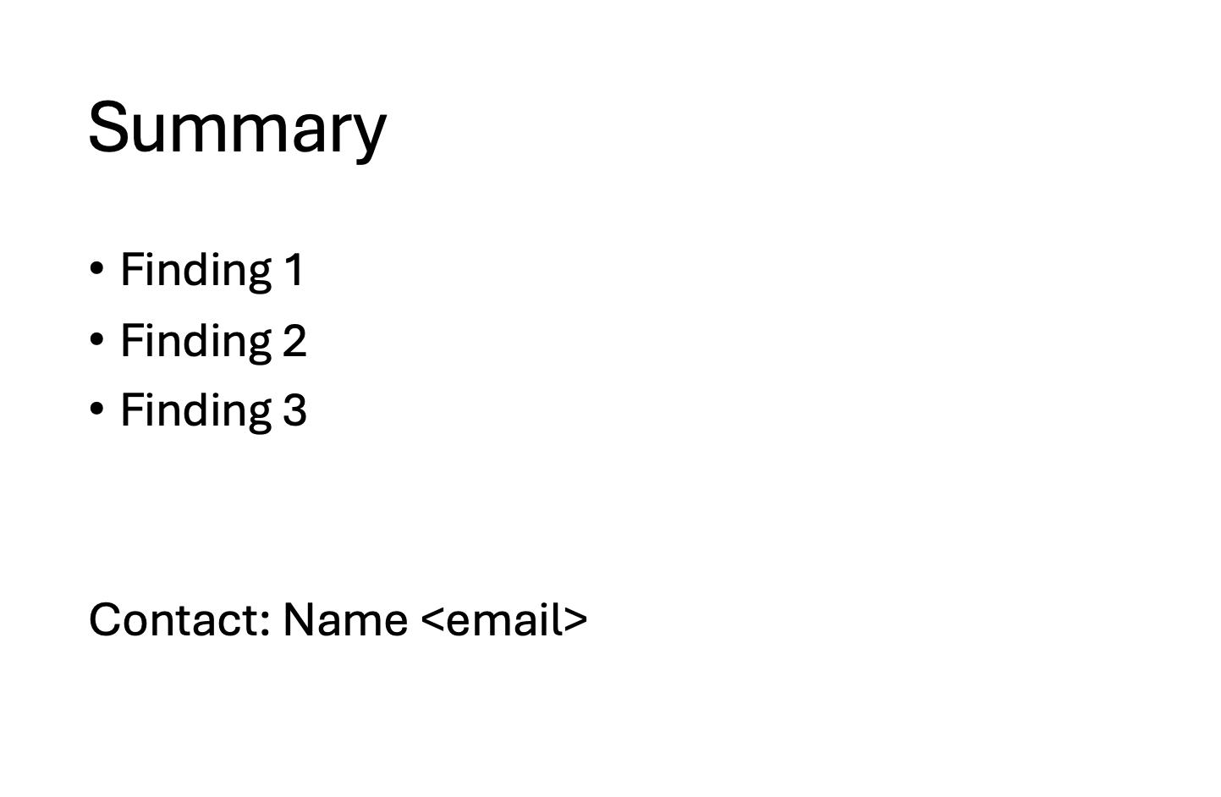
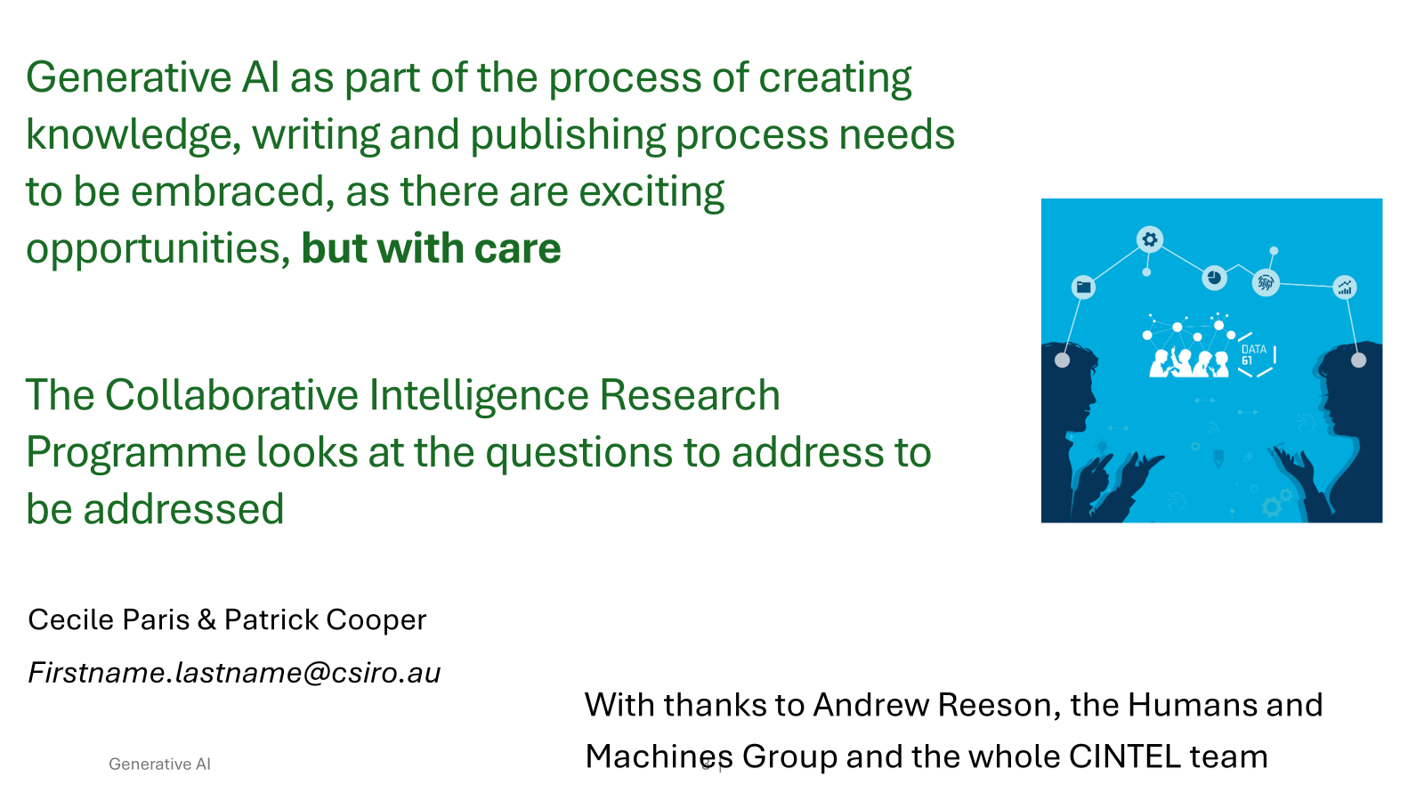
Outlines are suitable for
long presentations (>20mins)

Slide 80
Small things can make a big difference
Use colours which are easy to see and distinguish [can you read this? ]
If you use colours, make sure they mean something - people will try to attribute meaning to them
Repeat slides rather than navigate forwards and backwards
Always number slides
Check your grammar and spelling
Check the syntax and punctuation of bulleted list of items
Notes:
Some notes below:
Colour blind: 1 in 12 men (8%) and 1 in 200 women.

Slide 81
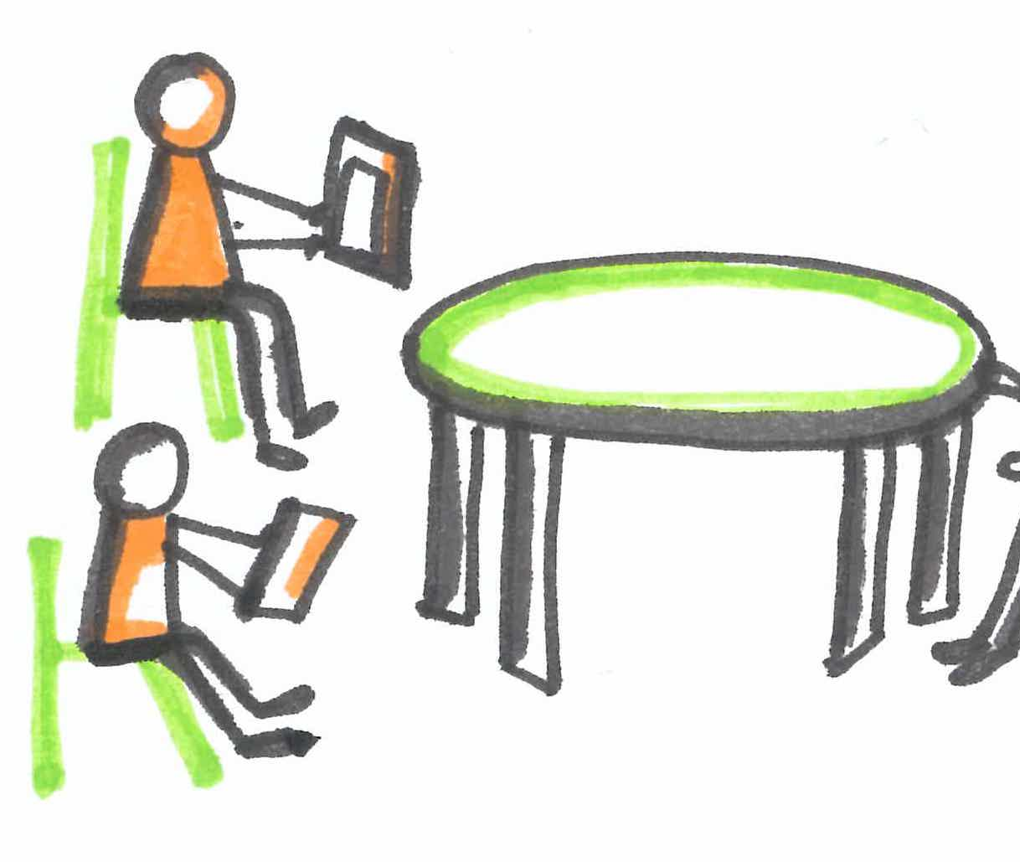
Getting prepared: prior to the presentation
Know what you are talking about (we can’t say it enough!)
Rehearse, rehearse, rehearse – at least once with an audience
Time yourself: make sure your talk will not run over the allotted time - without having to rush and speak too fast!
Learn your script so that you can engage with the audience - don’t read what’s on the slides

Slide 82
Getting prepared: Using the tools
Make sure you are familiar with all the basic machinery
In particular, ensure you know how to advance slides
Arrive early for the session to give you time
Notes:
Arriving early is often requested by session chair - do follow their advice!
Familiarise yourself with all the different ways to advance the slides
Explore the functionalities that the presentation tool provides
Test audio and video if you have some in your talk

Slide 83
Presenting: Speaking
Articulate, breathe and pause
Adopt a lively tone
Speak at an appropriate volume for the venue
Be present
Watch out for distracting verbal behaviours (e.g., “fillers”)

Slide 84
Presenting: Interacting with the Audience
Don’t start by apologising for feeling nervous
Always look at the audience - but don’t just look at 1 person!
Try to avoid using/looking at notes

Slide 85
Presenting: Interacting with the Audience
Don’t start by apologising for feeling nervous
Always look at the audience - but don’t just look at 1 person!
Try to avoid using/looking at notes
Engage the audience by asking them a relevant question at the beginning (If you can)
Only use humour if you are confident it will work
Try to develop a relaxed style, but one that shows authority

Slide 86
Presenting: Body language
Body language is really important
Minimise nervous habits
Remember to breathe
Use the space available (if possible)
Use your hands to add expression to your talk
Point to things on the screen… But don’t look at the screen behind you
Notes:
Body Language in Presentations: +How to Use It Effectively | Envato Tuts+ (tutsplus.com)
Experts agree–between 70-90% of communication is nonverbal. Now, that number often includes vocalization in addition to body language, but the upshot is clear: how you use your body and gestures matters just as much as what comes out of your mouth
Smile - assume a power pose, or a “base” pose; move towards the audience (engage, look at them); don’t slouch; make use of the space (if you can); don’t be afraid ti gesture, but they have to be meaningful and not simply show nervousness; speak clearly; minimise nervous habits (e.g., arms crossed; dans in pockets; indicates that you are nervous); maintain eye contact; remember to breathe! Study great presenters
The Importance of Body Language in Presentations (moderngov.com)
Effective Use of Body Language as a Speaker — The Speaker Lab –
Watch out for physical behaviour that the audience may find distracting

Slide 87
Asking Questions
Must come from a space of curiosity
Articulate the question carefully and concisely
Be friendly
Thank the speaker
Notes:
Body Language in Presentations: +How to Use It Effectively | Envato Tuts+ (tutsplus.com)
Experts agree–between 70-90% of communication is nonverbal. Now, that number often includes vocalization in addition to body language, but the upshot is clear: how you use your body and gestures matters just as much as what comes out of your mouth
Smile - assume a power pose, or a “base” pose; move towards the audience (engage, look at them); don’t slouch; make use of the space (if you can); don’t be afraid ti gesture, but they have to be meaningful and not simply show nervousness; speak clearly; minimise nervous habits (e.g., arms crossed; dans in pockets; indicates that you are nervous); maintain eye contact; remember to breathe! Study great presenters
The Importance of Body Language in Presentations (moderngov.com)
Effective Use of Body Language as a Speaker — The Speaker Lab –
Watch out for physical behaviour that the audience may find distracting

Slide 88
Posters

Slide 89
The Poster: again, an advertisement for your paper, your work and yourself
What it is not
What it is
A set of slides put one next to the other
Large bodies of text no one will want to read
A narrative
Attractive
Informative
Easy to read
A take home message

Slide 90
Poster presentation is interactive
One on one (or several) discussions
Keep to your narrative and remember your take home message

Slide 91
Poster presentation is interactive
One on one (or several) discussions
Keep to your narrative and remember your take home message
Be present and engaging - speak in the official language of the conference

Slide 92
Poster presentation is interactive
One on one (or several) discussions
Keep to your narrative and remember your take home message
Be present and engaging - speak in the official language of the conference
Meet other researchers in person and exchange ideas
Expand your network even for the shy and introvert

Slide 93
Demo

Slide 94
Demos are the best way to show off new applications
Some papers introduce a new tool or application
Demos are the best way to present applications in practice
Demos allows others to interact with the application and discuss it with you directly
Demos may be an opportunity to get inspired for new features by talking to others

Slide 95
Demos are interactive
Introduce the problem you are solving
Go through the demo slowly, explaining each step (and their purpose)
Allow others to ask questions, interact with the application and discuss it with you directly
Be careful to not click everywhere on the screen

Slide 96
From your experiences listening to talks…. Other tips?

Slide 97
Social Media
Blogs
LinkedIn
Twitter/X
Mastodon
*ACL Publicity accounts

Slide 98
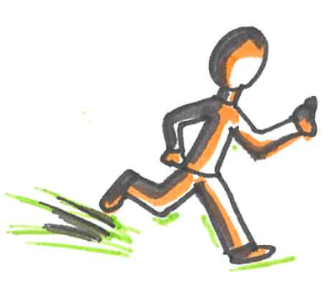
Social Media and Research Outreach
It’s fast!
It can promote your research if done right
It highlights what you want your audience to pay attention to
It needs a take home message (like a “presentation”)
Must be very much to the point

Slide 99
Keep your posts genuine!
Posts should be fact-based and you must be able to back them up (e.g., by a publication)
Otherwise it could ruin your reputation as researcher
It potentially is there forever
People can sense show offs! Might not help your popularity

Slide 100
Drawbacks of relying on social media content
Not peer-reviewed and therefore there is no quality control
Should not take claims as is and would need to verify them
Just because someone is a well-known researcher does not mean their claim is always correct, sometimes can be a trigger for discussions
Our LLM is better than any other in the world! As per one experiment on two datasets we happen to have!
Notes:
As a reader

Slide 101
Only success is shared
Social media can make readers feel overwhelmed!
Not all share on social media platforms
Often only success is shared, not rejections
We had 10 papers accepted at ACL!
Are you as good as us?
Our 4 papers got rejected :-(

Slide 102


Short-text forums: What to share and how
New publications
That ACL paper you got accepted or the new journal publication
TL;DR version: a perfect teaser
A link to the ACL anthology version for a full-version
Upcoming talks
A title that is informative and attracts attention
Details on how to attend (Date, time, mode)
A past event
A notable event that you either attended or presented
The idea you presented
Something you learned that is worth sharing

Slide 103
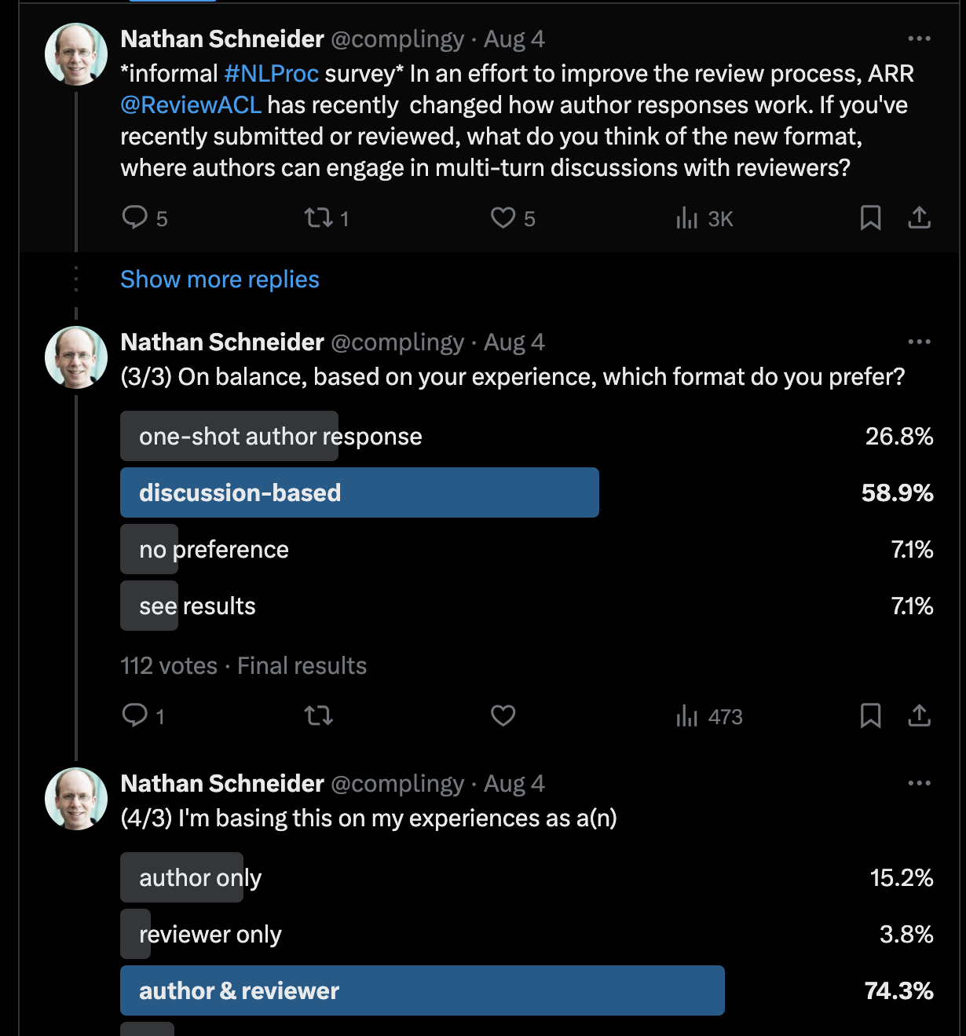
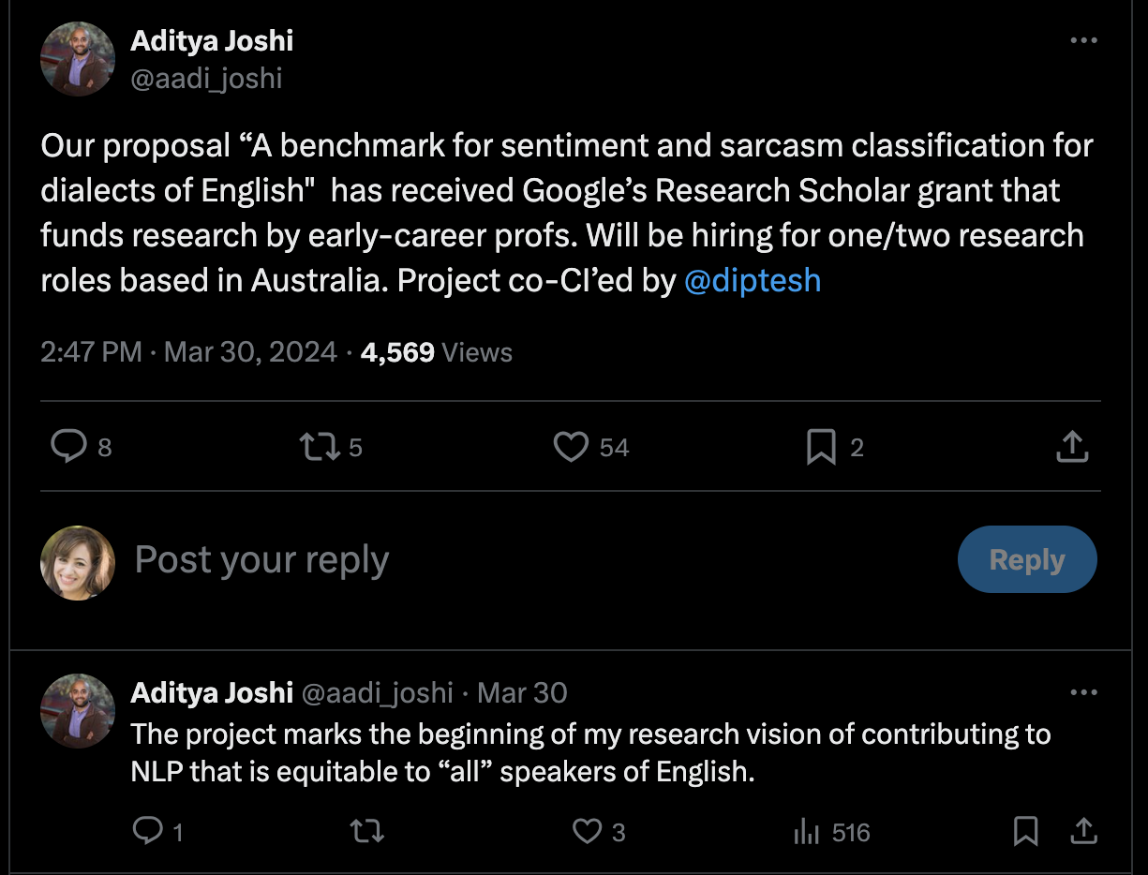
Promotes their work/recent grant.
It shows their topic of expertise too.
Seeks engagement from the NLP community for a poll that is of interest to many!
Notes:
Taking surveys/polls, promoting their work/recently accepted grant

Slide 104
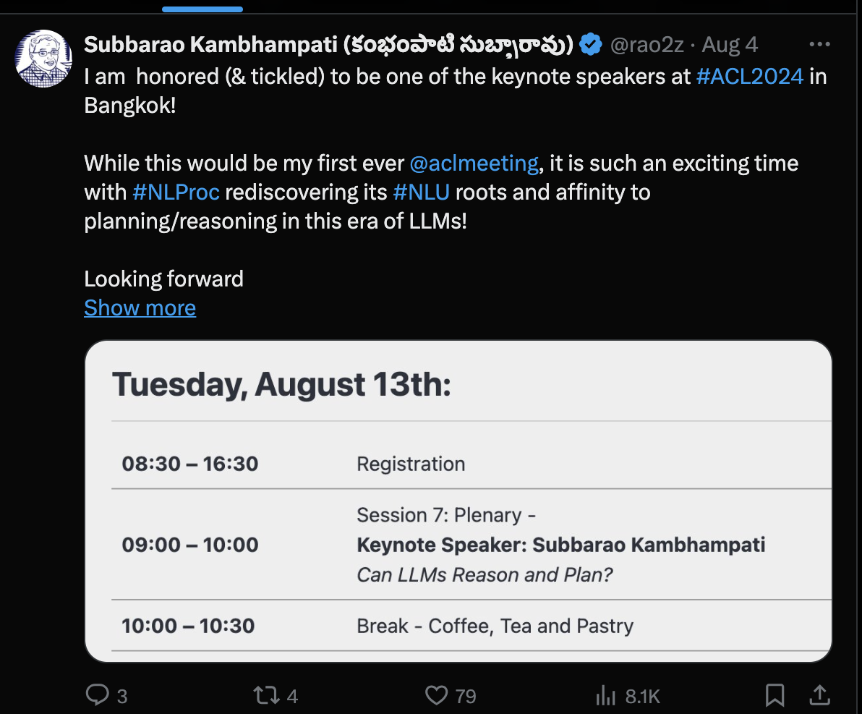
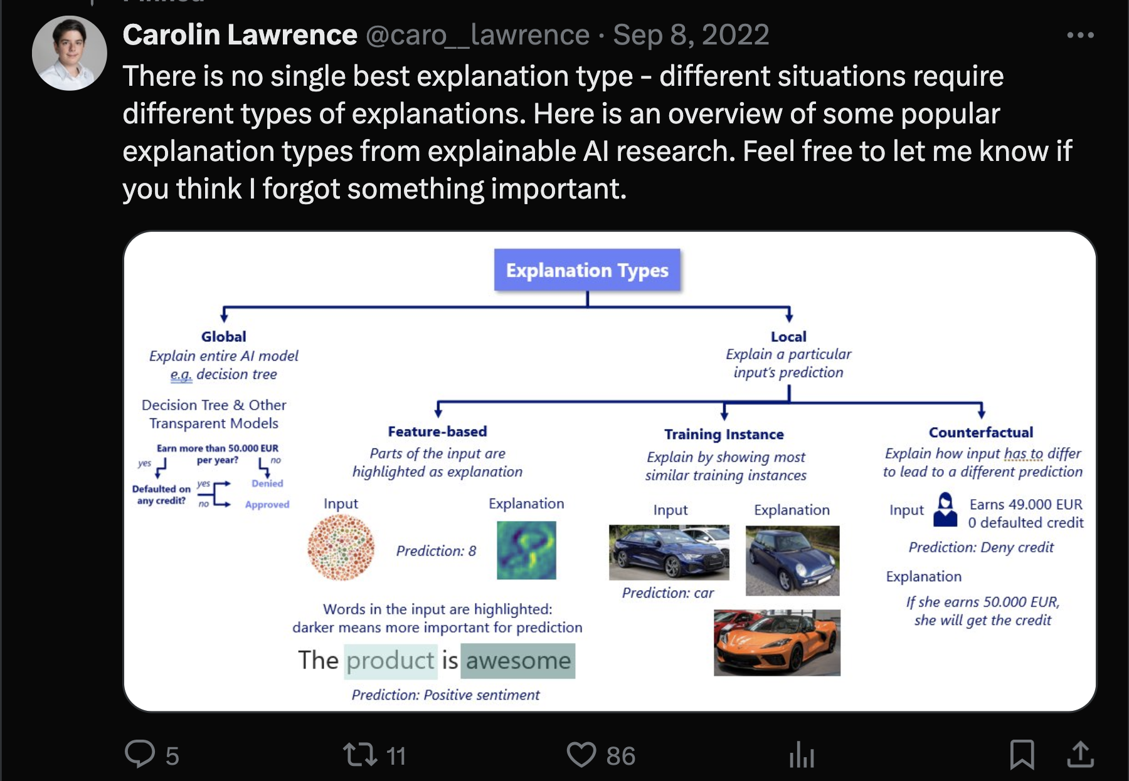
Shows knowledge of the subject, yet invites others for contribution!
Draws attention to their upcoming keynote, with all the details.
Notes:
Pay attention to someone’s upcoming talk

Slide 105
Blogs
Writing about a topic of interest, such as explaining your latest publication for the general public
Each post focuses on one topic only
It should be self-contained to be understood!
Figures and tables should be explained
Formulas and equations should be self-contained

Slide 106
Blogs are not papers
Paper | Blog post
Formal | Formal/Informal
Sell your idea | Tease your idea so the readers read your paper
Audience: Reviewers, Researchers | Audience: General public, Researchers who want the gist of your work
All details are needed | No need to provide all the details (e.g., equations can be skipped)
Adopted from Carolin Lawrence’s slides on Scientific Writing for Blog Posts

Slide 107
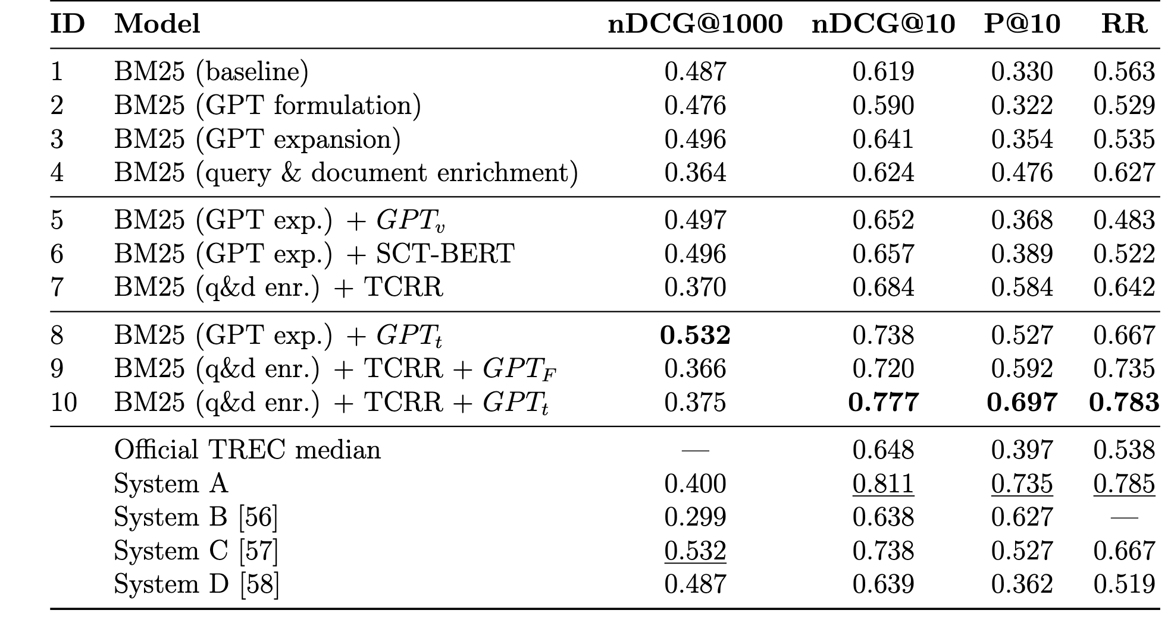
Results
Rybinski et al. Learning to Match Patients to Clinical Trials Using Large Language Models. 2024
Notes:
What if someone drop this on a blog? Is it useful for you to read?

Slide 108
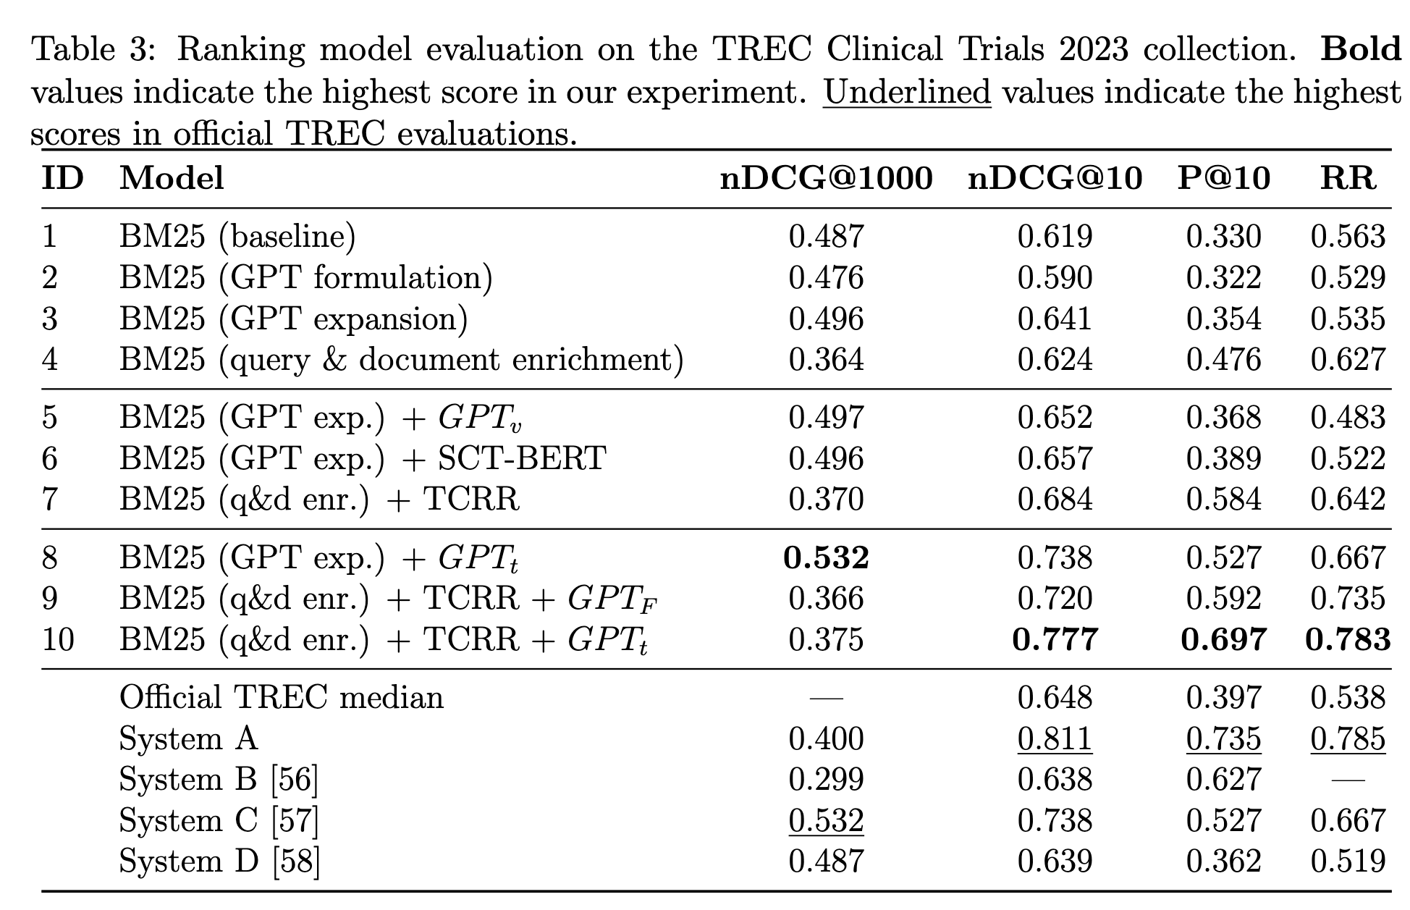
Notes:
How about now? Can you understand it? What information is missing?

Slide 109
What if we replace the table with this?
“We attain the best results with systems that leverage re-ranking with a trained LLM, which highlights the effectiveness of the proposed strategy to use the model's graded output directly in a re-ranking process via rank fusion.”
More details at: DOI/URL.

Slide 110
Your audience defines the details needed!
General Audience | ML/NLP Researcher | Fellow researcher or someone in your exact field
Needs minimal details | Some details | Most details
Goal is to know why this is important and maybe challenges | What’s that new trend or method in the field | Details of a related literature they need to know
Spend more on introduction and an understandable take-away message | Some introduction, some details of methods and what they can take to other fields | Least introductions, methods and results explained and why or how this will advance the field
Adopted from Carolin Lawrence and Barbara Plank slides on Scientific Writing for Blog Posts

Slide 111

LinkedIn
Professional posts
Create an image of you and your work
Let others know that you are looking for new opportunities
Announcements
Events that you may be organising (e.g., workshops)
Recent publication or talk
Significant milestones or achievements

Slide 112
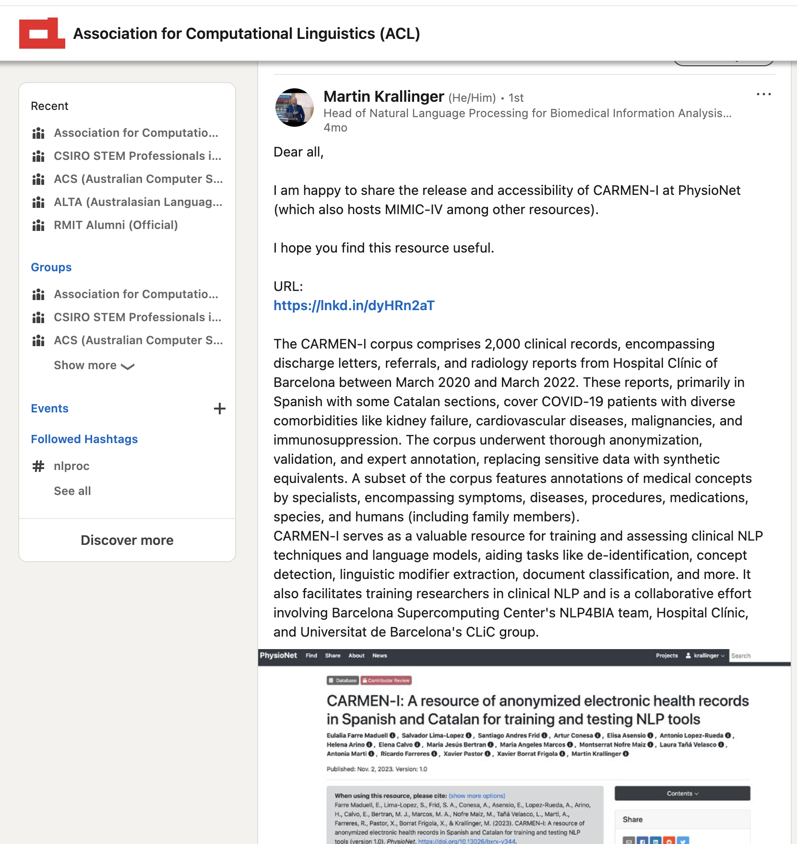
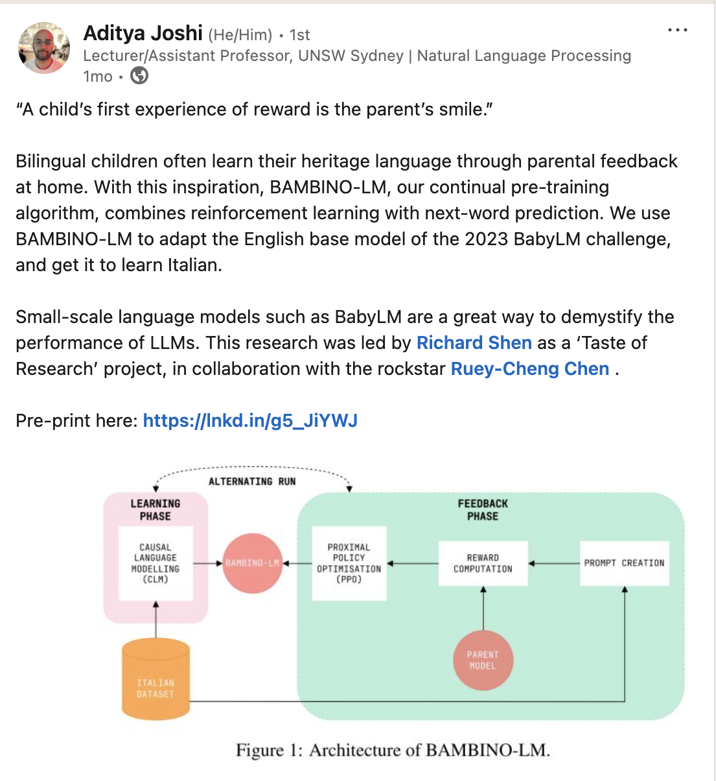
Sharing a resource which can be useful for others in the NLP community
An easy to follow explanation of an upcoming publication.
Notes:
Both these posts are to improve the visibility of the work done by their authors

Slide 113
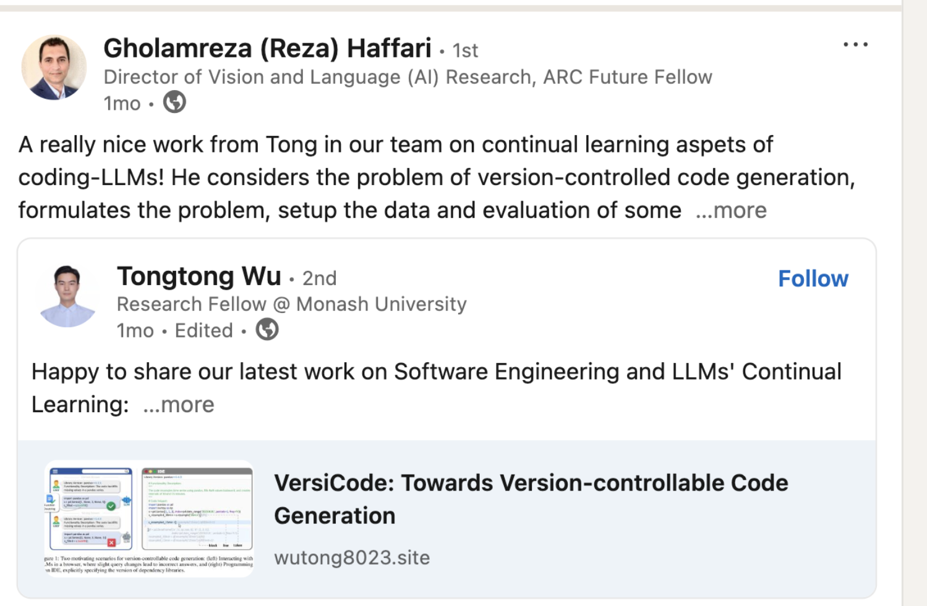

Slide 114
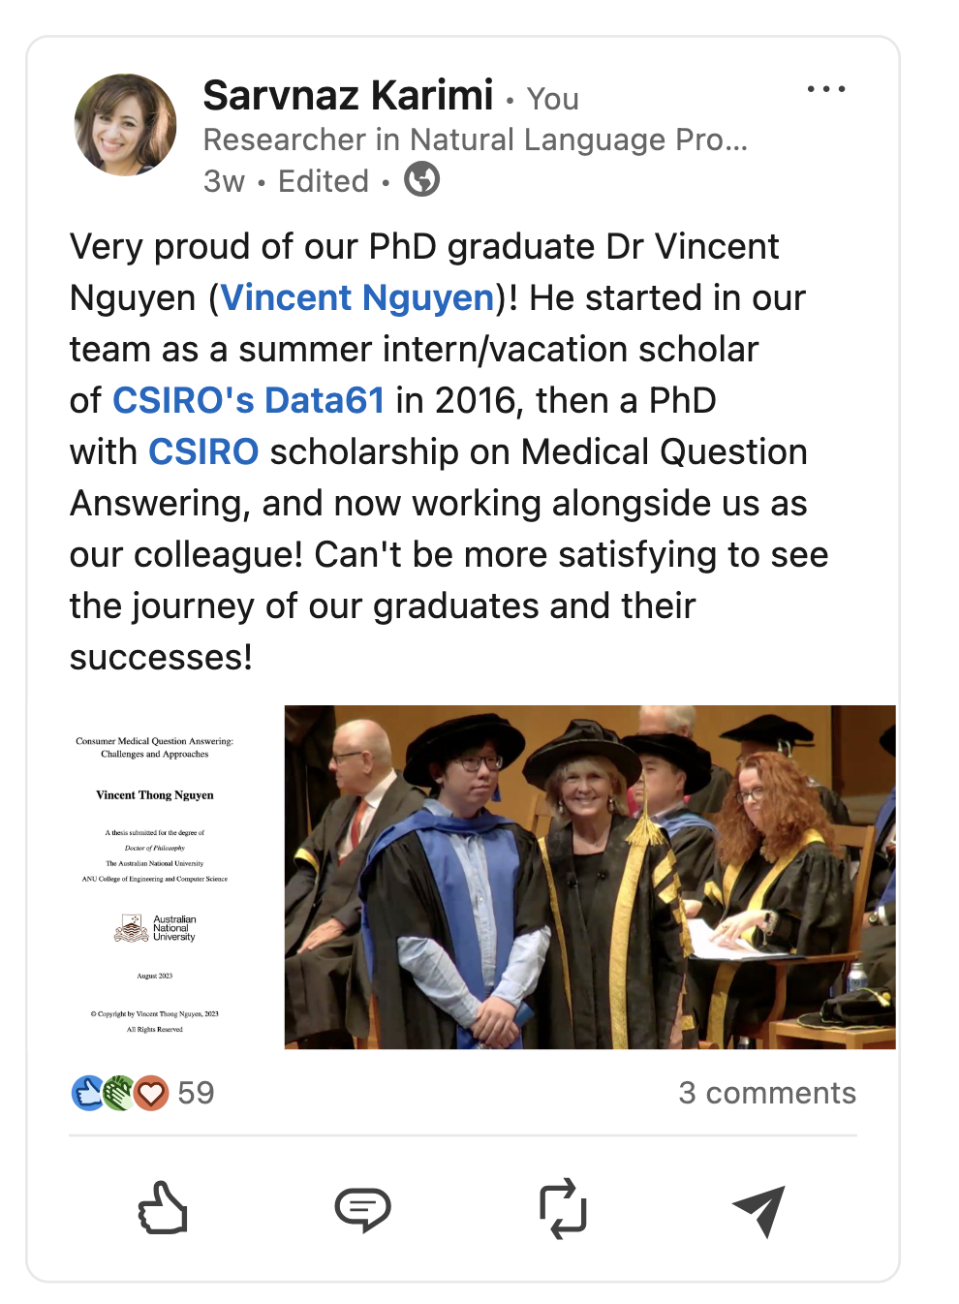
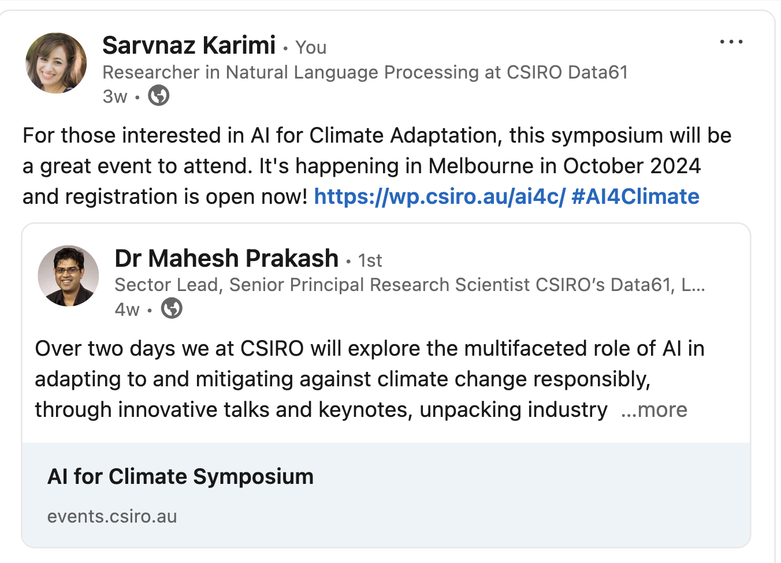

Slide 115
Not LinkedIn
Personal updates that may be best kept private
Engaging with unprofessional discussions
Unprofessional comments about others
Attacking a (past) colleague or organisation
Gossips that may ruin your reputation later on

Slide 116
Here are photos of my kid playing!
Universities at country X are bad!
That professor at university Y is unethical and fraud! Because I say so!
Can you go on a date with me? I like your research!
Method X proposed by Y is not working on my dataset! Therefore that researcher is a fraud!

Slide 117


*ACL’s Official Accounts
From 2019, all the social media accounts are streamlined:
@aclmeeting
@naaclmeeting
@aaclmeeting
@eaclmeeting
@emnlpmeeting
ACL Group on Facebook and LinkedIn
Notes:
On Linkedin → only those who have a profile (ideally complete name) will be accepted to avoid having to moderate posts.

Slide 118
*ACL’s Hashtags
#NLProc : any generic NLP-related post
Conference-related:
#ACL<year>NLP
#AACL<year>
#EACL<year>
#NAACL<year>
#EMNLP<year>
Notes:
On Linkedin → only those who have a profile (ideally complete name) will be accepted to avoid having to moderate posts.

Slide 119
For future publicity chairs of *ACL conferences
Contact the ACL publicity director early on!
(ACL officers: https://www.aclweb.org/adminwiki/index.php/ACL_Officers)
There is a handbook that collects past publicity chairs input
Publicity chairs should be proactive and use new content to keep the information flowing
If done right, it reduces some load off the conference co-chairs

Slide 120
ACL Announcement
Contact the ACL publicity director to send emails to mailing lists (e.g., corpora, ML news)
Email: announcement@aclweb.org
Organising a workshop/tutorial in *ACL conferences: This may be a good option
ACL Member Portal: Only goes to the ACL Members

Slide 121
Interviews
PhD positions, Internships and Postdoctoral Fellows

Slide 122
What are the interviews for?
Interviewers want to know if your skills match their need
It’s mutual
you need to decide if the job and workplace matches your expectations
Ask questions & be curious

Slide 123
PhD positions
Check for universities with an active NLP group
Find supervisors that publish in the NLP venues (e.g., *ACL/EMNLP/COLING/LREC)
Different continents and countries have their own procedure. Read the information before applying!
US
Europe
Australia
Asia
Africa
Notes:
Or linguistics

Slide 124
Internships
Short-term jobs
Gives you a flavour of what to expect after PhD
Opportunity to work with those researchers you wish to learn from
Can open more options after graduation
May lead to one or more publications
May lead to scholarships

Slide 125
Postdoctoral Fellow (postdoc) or Research Fellow
Early career researchers
Typically 2-3 years after PhD
Same as PhDs, postdoc positions are different in different continents
In Australia: Typically 3-years
One project
Aim is to get you ready for the next job (industry or academia)
Publish as much as you can!

Slide 126
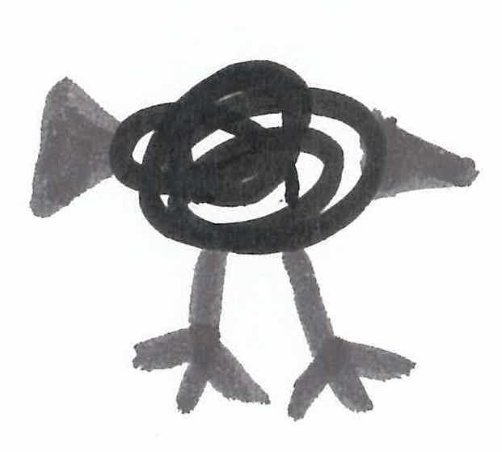
Applying for jobs or PhD positions
A current CV/Resume
A cover letter to state why you wish to be considered for a given position
Any relevant documents (if asked) such as university qualifications
A list of references (check with them first, and ask permission)

Slide 127
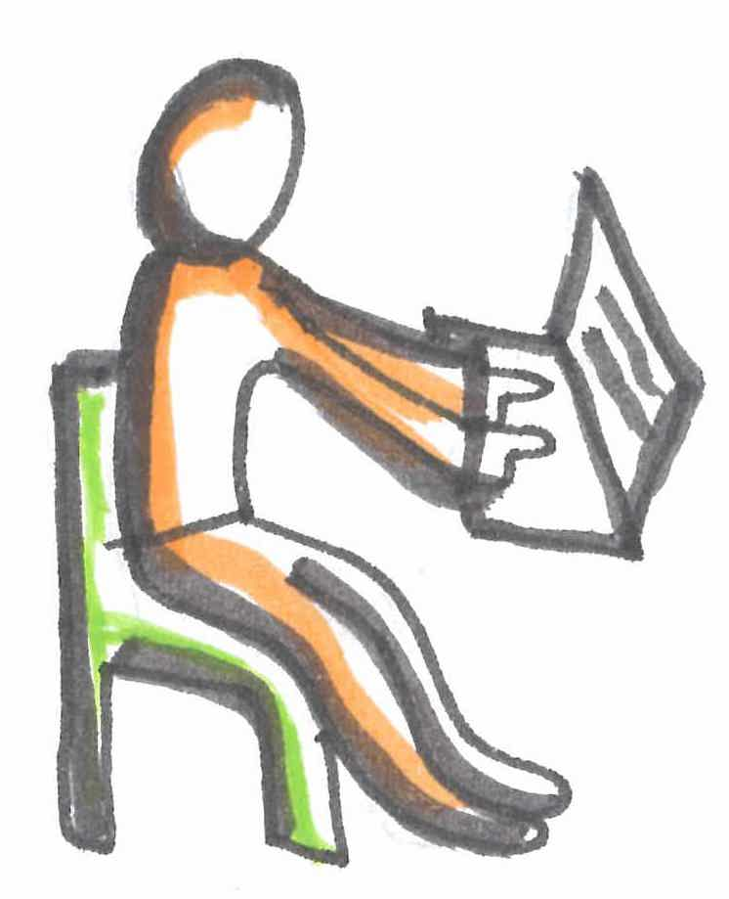
So, you’ve been asked to do an interview
Congratulations! It’s great to be shortlisted!
Communicate immediately if there are date and times you are not available.
Time to prepare!
Also known as “do your homework”!
Make sure you know the organisation: what they do and why
The interviewers background (if known in advance)
Some questions to ask about the job!

Slide 128
Interview day
Be punctual!
If you cannot make it, let them know as soon as possible (cancel or rearrange)
Check in advance that the technology works (online)
If you’re to rely on technology for translation, let them know

Slide 129
Introduce yourself!
It is vital to get this right!
Explain your PhD in an elevator pitch level
Be ready to explain your papers, your contributions
Say what you learnt in the previous position (skills)
It’s about me!
PhD
Honours
Masters
Internship
…

Slide 130
Listen to Understand
Only way to be able to answer a question is by understanding it!
No need to rush! Ask for clarification! Check your understanding if not sure!
Notes:
Took the idea from Reza: 7 Habits of Highly Effective People
“Communication is the most important skill in life. You spend years learning how to read, write, and speak. But what about listening? What training have you had that enables you to listen so you really, deeply understand another human being? Probably none, right?”

Slide 131
How to answer questions during an interview
Answer the questions directly and honestly
Facts only
Examples
Have you applied for a PhD admission yet? The answer is yes or no. You can also mention when, outcomes.
Do you have a paper published in an *ACL venue? Yes or no. “Thinking about writing” is not an acceptable answer.
Again, ask for clarifications if unsure
It shows you care and you can have a conversation

Slide 132
What if I do not know the answer?
“I don’t know” is a perfect answer!
Interviewers would appreciate:
Honesty
Not having their time wasted with irrelevant fillers

Slide 133
What to avoid during an interview
Unproductive criticism
Criticise the interviewer’s research to show you’re aware of their work
It’s not a peer-review process!

Slide 134
What to avoid during an interview
Unproductive criticism
Criticise the interviewer’s research to show you’re aware of their work
It’s not a peer-review process!
Too much reliance on trends
What is currently on-trend is not all that matters (respect past work)
SVMs can still be useful in some applications
LLMs are not the answer to all problems

Slide 135
What to avoid during an interview
Unproductive criticism
Criticise the interviewer’s research to show you’re aware of their work
It’s not a peer-review process!
Too much reliance on trends
What is currently on-trend is not all that matters (respect past work)
SVMs can still be useful in some applications
LLMs are not the answer to all problems
Unwanted slides and materials
If the panel is not asking for a presentation, do no insist on that
Reliance on prepared material can derail you from listening and answering the questions

Slide 136
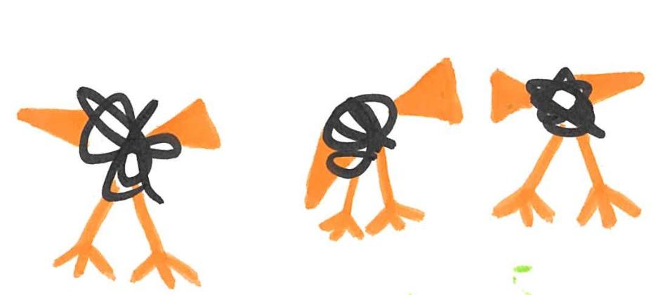
Follow ups: More interviews
Depending on the position, some interviews are followed by
Coding tasks
Talks to a larger audience
Requests for documents or providing evidence
References: This is different in different counties (e.g., in Australia usually only if a candidate makes it to a potential hire; in the US done before interviews)

Slide 137
Follow ups: Interview talk
Audience: Ask in advance who will be in the audience
Are they all NLP experts? Will they know your area of expertise?
Time: Ask about your allocated time and stick to it! That’s respect to their time and schedule!
What to Present: You may want to present a summary of multiple projects or your most prominent one.
Slides filled with equations and tables of results may not be as impressive as you may think.
They want to know: are you able to communicate your research well?
Notes:
If you’re asked to present a talk as part of an interview process
You cannot use an existing conference talk

Slide 138
Follow ups: Verbal or Written Outcome
Negative:
Keep it professional and polite! You may re-apply or meet them in a conference!
Learn from the feedback
Positive:
Do acknowledge that you received it
Have an answer ready (accept or not) and and when can you start

Slide 139
From your experiences of interviews…. Other tips?

Slide 140
Almost there!
Notes:
To do: put time estimates here.

Slide 141
Acknowledgements
We are grateful for the materials provided to us by our colleagues:
Prof. Robert Dale
Prof Guilin Qi
Prof. Barbara Plank
Prof. Wray Buntine
Dr Simon Peyton Jones
Dr Carolin Lawrence
Zhijin Jin and others in the ACL Mentorship program

Slide 142

Summary
Know your audience!
Have a take home message, story and stick to it!
Prepare, prepare, prepare!

Slide 143
Resources

Slide 144
Writing Checklist
 | Re-read the abstract and conclusions to ensure they match the story.
 | Contributions are listed in the introductions.
 | Check all the acronyms are expanded in their first mention in the text.
 | All the tables and figures are referenced in the text.
 | Spell-check and grammar check before submitting.

Slide 145
Presentation Checklist
 | Slide numbers
 | Meaningful final slide with maximum of three take home messages
 | All the colours are visible
 | Proofread
 | Each slide has one message

Slide 146
Social media post Checklist
 | Is this a meaningful content?
 | Is it respectful?
 | Is it professional? Will I be proud of it 5 years from now?
 | Have I proofread properly?
 | Is the media such as photos content mine to post (copyright)?

Slide 147
Interview Checklist
 | Ready to explain my past research (PhD/Master/Honors) in 2-3 sentences
 | Have read about the organisation and know what they do
 | Ready to talk (meaningfully) about my publication(s) in details if they ask
 | Checked all the equipment such as headset works (if online)
 | Questions ready to check if this is the position for me

Slide 148
Resources
Presentations:
How to give a good talk on a Computational Linguistics topic (Barbara Plank) https://naacl2018.wordpress.com/2018/05/27/how-to-give-a-good-talk-on-a-computational-linguistics-topic/
https://www.cs.jhu.edu/~jason/advice/how-to-give-a-talk.html (Jason Einser)
https://en.itu.dk/Research/PhD-Programme/PhD-Courses/PhD-courses-2021/PhD-Course---Communicating-State-of-the-art-NLP-Research-to-a-Broader-Audience
Covey, S. R. (2004). The 7 habits of highly effective people (book)

Slide 149
Resources
Writing:
Writing for Computer Science (Justin Zobel) - Book
Explaining explaining: a quick guide on explanatory writing (Lucas Costa) https://lucasfcosta.com/2021/09/30/explaining-in-writing.html
Tips for Writing NLP Papers (Vered Shwartz) https://medium.com/@vered1986/tips-for-writing-nlp-papers-9c729a2f9e1f
PhD applications:
PhDs in Europe: https://soundcloud.com/nlp-highlights/134-phd-application-series-phds-in-europe-versus-the-us
PhDs in the US: https://soundcloud.com/nlp-highlights/133-phd-application-series-preparing-application-materials-with-nathan-schneider-and-roma-patel

Slide 150
Resources
ACL Mentorship:
- ACL Mentorship YouTube videos: https://www.youtube.com/watch?v=jFWF0PX4Pcs&list=PLqX2Wb03yR2Sg6eM4xHujbHIyqnvaIufy
- ACL mentorship home page: https://mentorship.aclweb.org/

Slide 151
Resources
http://users.umiacs.umd.edu/~jbg/static/style.html
https://www.microsoft.com/en-us/research/academic-program/write-great-research-paper/
https://www.youtube.com/watch?v=TCytsY8pdsc
https://www.wiley.com/en-us/network/publishing/research-publishing/writing-and-conducting-research/how-to-write-a-scientific-abstract
https://www.youtube.com/watch?v=pbrxGnL3tvQ
https://aaai.org/aaai-conference/reproducibility-checklist/
https://www.youtube.com/watch?v=0h8woOdNSN4

Slide 152
Resources
Research is communication (frankxfz.me) provides some good ideas for writing a good scientific paper.
how-to-be-a-successful-phd-student.pdf (frankxfz.me) has good suggestions about when to write.
For many NLP projects, it would be great to include one or two sentences summary in the introduction to highlight the key contributions of this work. The reviewers can easily reuse such sentences in peer reviews.
It would be great to understand the peer review process and mitigate some common pitfalls via good writing. What Can We Do to Improve Peer Review in NLP? - ACL Anthology and the recent white paper 2405.06563 (arxiv.org) written by us.
Behavioral consequences of second-person pronouns in written communications between authors and reviewers of scientific papers https://www.nature.com/articles/s41467-023-44515-1

